Slide 1
BASIC CONCEPTS OF .NET FRAMEWORK
Prepared By
SAI KIRAN BEKKANTI

Slide 2
Contents
Framework
Framework VS Library
Visual Basic
IS .NET a Platform dependent ?

Slide 3
.NET FRAMEWORK
framework is a real or conceptual structure intended to serve as a support or guide for building of something that expands the structure into something useful.
.NET Framework is a software framework that is designed and developed by Microsoft.
The first version of .NET Framework was 1.0 which came in the year 2002.

Slide 4
LIBRARY | FRAMEWORK
We can control the flow of the program. It can be invoked whenever and wherever we like. | Unlike in Libraries, The overall program’s flow of control is not with us, But by the framework.
It provides reusable functionality for a code | A user can extend the framework.
We can Modify the Library. | A user cannot modify the existing code.
The Intent of library is to provide reusable software functionality | The Intent of a framework is to reduce the complexity of the software development
EX: Jquery | Ex : AngularJS

Slide 5
VISUAL BASICS
Visual Basics is a language came before .NET which is of version 6.0
Most Visual Basics controls provide the ability to drag and drop within a program.
It is a time saving process, As it is mostly focused on the graphical user interface which is attracted the people alot.
It is very easy to implement any application using this.
It’s not a case sensitive, To overcome that issue Microsoft introduced VB.NET
wherever we like.
ke in Libraries, The overall program’s flow of control is not with us, But by the framework.

Slide 6
.NET framework is a Platform Dependent. Which only runs on Windows.
.NET core is Platform Independent.
The mono company has taken the .NET framework and extended the .NET framework to run the application on different operating systems.
And they built a different environment called CLR which is a runtime environment.
Common Language Runtime(CLR) : It is a runtime environment which executes the code written in any .NET programming language .
The Mono company introduced different CLR’s for Linux as well as for MacOS.
The mono company has implemented a framework called Xamarin. As, it maintains a single code base.
Xamarin is an open source platform for building modern applications for IOS, Android and Windows.

Slide 7

TOPICS DISCUSSED ON 1-FEB

Slide 8
Compiler VS Interpreter
.NET Framework Components
Singleton over static

Slide 9
COMPILER | INTERPRETER
Compiler takes the entire program in one go | An interpreter takes a single line of code at a time
The compiler generates an intermediate machine code | The interpreter never produces any intermediate machine code
Errors are displayed after entire program is checked | Errors are displayed for every instruction interpreted
It is comparatively faster than interpreter | It is slower than compiler
It requires more memory management due to the creation of object code | It requires less memory as it does not create intermediate object code
It is difficult to find error detection | It is easier compare to compiler
EX: C,C++,C# | EX :Ruby, PHP

Slide 10
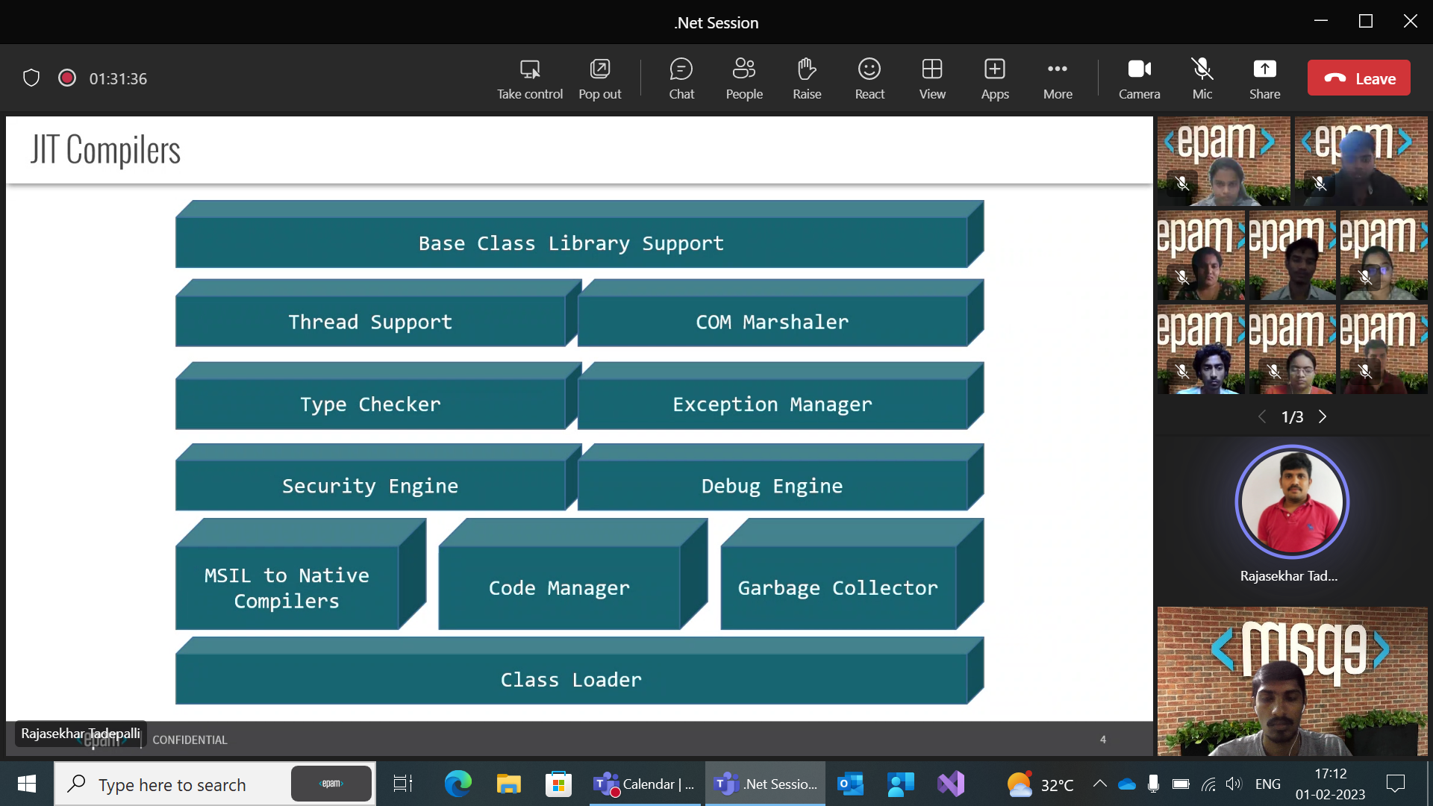

Slide 11
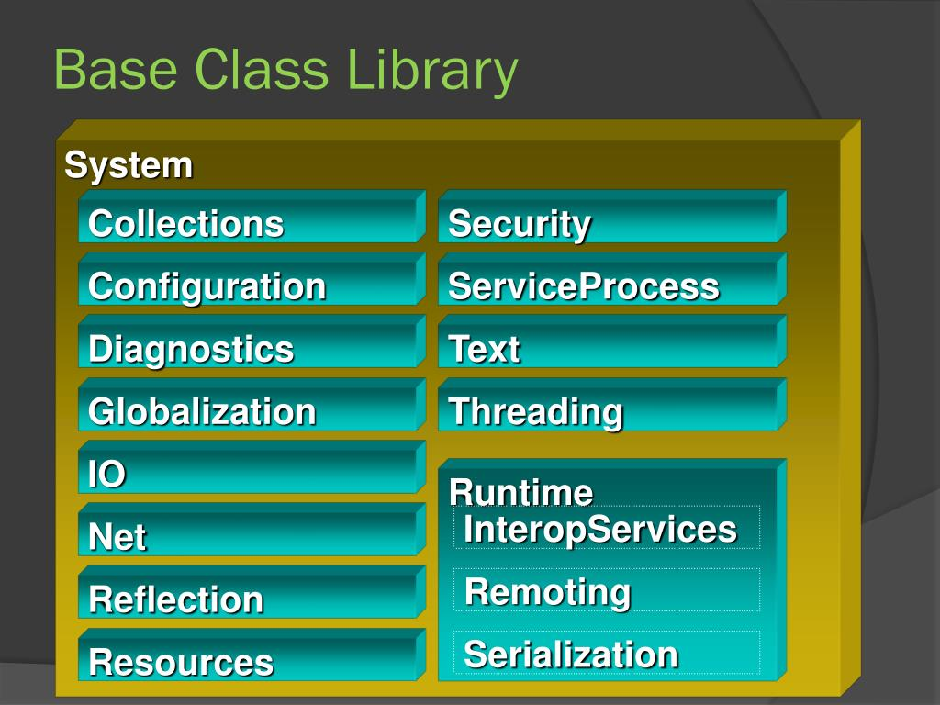
BASE CLASS LIBRARY
BCL stands for Base class library also known as Class library (CL).
The BCL contains multiple libraries that provide various features such as Collections, I/O, XML etc. for the multiple.NET programming languages.
As well, it contain some non-standard features such as LINQ, ADO.NET (for database interactions), drawing capabilities, forms and web support.

Slide 12
Namespace | brief description
System | contains the fundamentals for programming such as the data types, console and arrays etc
System.Data | is the namespace for ADO.NET
System.IO | provides connection to file system and the reading and writing to data streams such as files
System.Collection | contains lists, stacks, hash tables, dictionaries
System.Text | provides the stringbuilder class.
System.ServiceProcess | used when a window service is required
System.Security | provides hashing and the ability to create custom security system using policy and permissions

Slide 13
Thread Support :The CLR provides threat support for managing the parallel execution of multiple threads .
The System.Threading class is used as the base class for this.
Marshaling :-It is the process of creating bridge between managed code and unmanaged code.
Managed code :In this the source code is compiled into intermediate language code which is under the control of CLR.
Unmanaged code:-The source code directly compiled into native code.
Type Checker :-It checks the data type of variable.
Exception Manager :- it handles the exception in both managed code and unmanaged code.

Slide 14
Code Manager :- It manages the code during execution and allocate memory to the objects.
Security Engine :-security engine in CLR handles the security permissions at various levels.
Debug Engine :- It finds the bugs from the program, It works with the operating system to provide debugging services such as execution control,expression evaluation.
JIT Compiler :-The jit compiler in the CLR converts the Microsoft intermediate language(MSIL) into the machine code.
Class Loader :-It is responsible for loading the class After checking the metadata.It performs resource checking, version checking and security checking.
Garbage Collector :-It manages the allocation and release of memory for user application.

Slide 15
Singleton pattern over a static class
It is not possible to inherit from a static class, while it is possible with Singleton pattern if you want to allow it so anyone can inherit from a single class override a method and replace the service .
It is not possible to write an extension method to the static class while it is possible for a Singleton object.
A Singleton can be lazily loaded, While a static class is generally initialized when it is first loaded.
A singleton objects can clone but not with the static class.
Using Singleton we can use thread synchronization techniques but we can’t do with the static.
Static classes are hard to test then singleton.

Slide 16
Debug VS Release
Binfolder VS Objfolder
Build, Rebuild, Clean Commands
PDB Files
CCM & RCM wrappers
JIT Compilers

Slide 17
Debug | Release
We use debugger for developing application | we use release to push .dll and .exe files to production
Error detection is main priority | Performance is given main priority
the code is not Optimized | The code is optimised
The application will be slow | The application will be faster
Debug symbols are allowed #if DEBUG ConsoleWriteLine(“hello”); #endif | All Debug symbols are removed

Slide 18
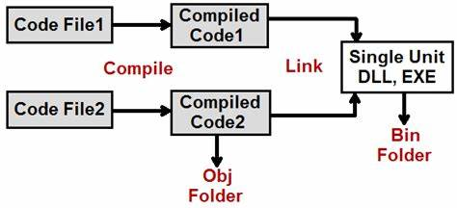
Binfolder & Objfolder
Obj folder cantains temporary files created during compilation where as Bin folder cantains exe and dll files combined.
By having obj folder incremental compilation happen.

Slide 19
Build , Rebuild , Clean Commands
BUILD :If there is change in files it will build otherwise it won’t build.
REBUILD: Irrespective of changes happened or not it will rebuild the solution.
In this first it will clean all files and then build from scratch.
CLEAN : It will clean all the dll or exe files in library & classes.

Slide 20
Rebuild VS Clean + Build
Rebuild
clean project 1 ---------> build project 1 ---------> Clean project 2---------------> build project2.
Clean + Build
clean project 1 ---------> clean project 2 ---------> Build project 1---------------> build project2.

Slide 21
PDB files
It is a binary file contains information released by debugger.
This files are generated by compiler when building a programme and can be used by debugger to help developers fix issues in code.
it contains information such as function names, location of variables and other metadata that allows a debugger to match the compiled code with source code.
If pdb file is removed, it won't affect the functionality of compiled program. the program run normally without pdb. But, the debugger will not have the access to information which results hard to fix bugs. Also pdb file provide meaningful stack traces so removing it may result less informative error messages.

Slide 22
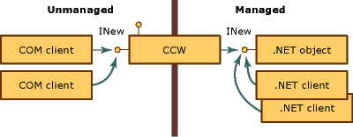
Com Collable Wrapper(ccw)
It is used for interoperability between .Net and unmanaged code in com environment.
It creates exactly one ccw for a managed obj, regardless of number of com clients requesting services.

Slide 23
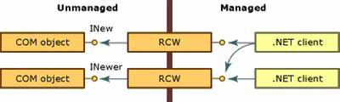
Runtime Collable Wrapper
RCM is used for interoperability between .Net and Unmanaged code in CLR environment.
It creates exactly one RCW for each com obj, regardless of no.of reference that exist on that obj.

Slide 24
Topics Discussed on Feb7

Slide 25
CONTENTS
01
Stack memory VS Heap memory
02
Garbage collection only sweep Heap
03
Data type classifications
04
collections
05
Types of Collections

Slide 26
STACK MEMORY | HEAP MEMORY
Static memory location | Dynamic memory allocation
Variables allocated on the stack are stored directly to memory | Variables allocated on the heap have their memory allocated at runtime .
Variables cannot be resized | Variables can be resized
Very fast access | relatively slower access
Stack contains primitive data types | It contains non primitive data types
The range is fixed in stack memory | It doesn't have fixed memory

Slide 27
Garbage collection only sweep Heap
The reason garbage collection only sweeps the heap and not the stack is because of the fundamental differences between the two memory structures.
The heap is a region of memory that is dynamically allocated at runtime and is used for objects
The heap is managed by the garbage collector, which frees memory occupied by objects that are no longer being used.
On the other hand, the stack is a region of memory used for function calls and local variables. which has limited size.
When a function is called, a new frame is created on the stack to store the function's parameters, local variables, and return address. Once the function returns, its frame is destroyed and the memory is freed.

Slide 28
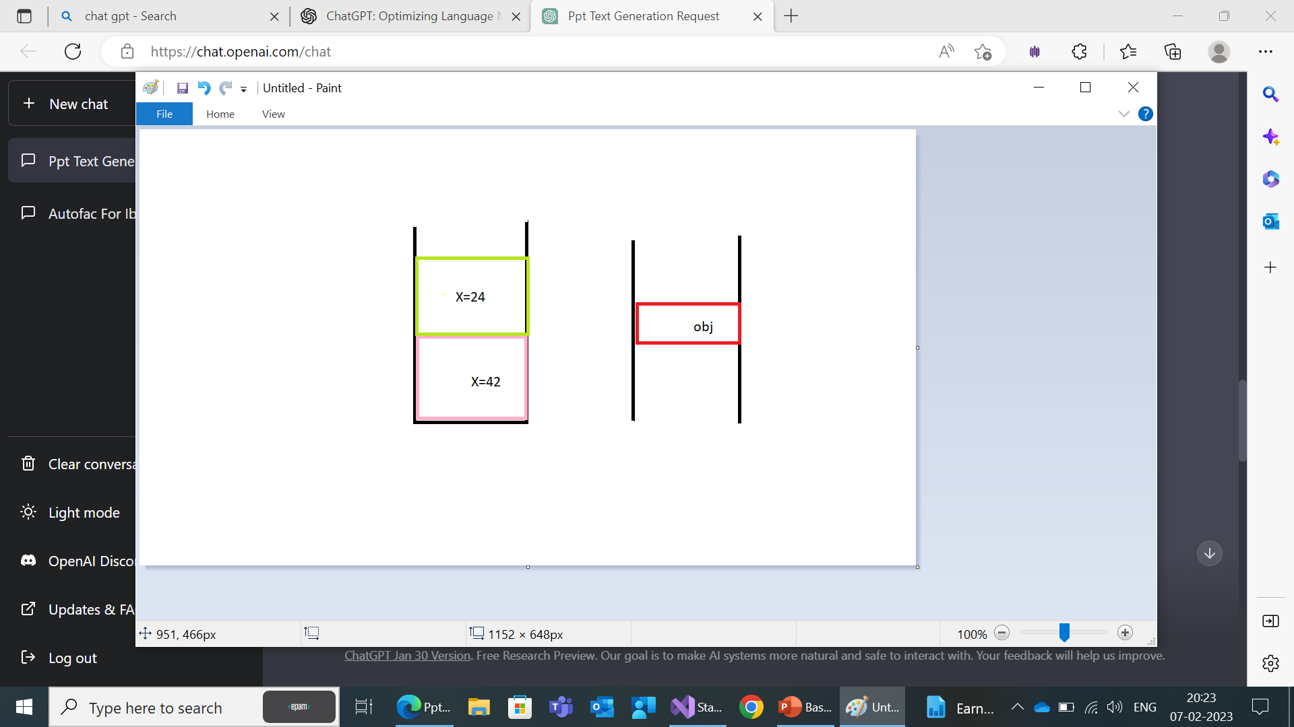
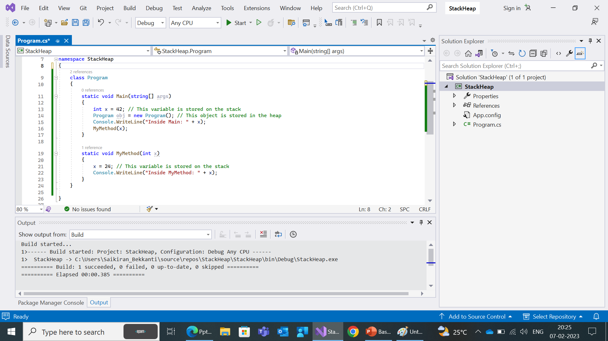

Slide 29
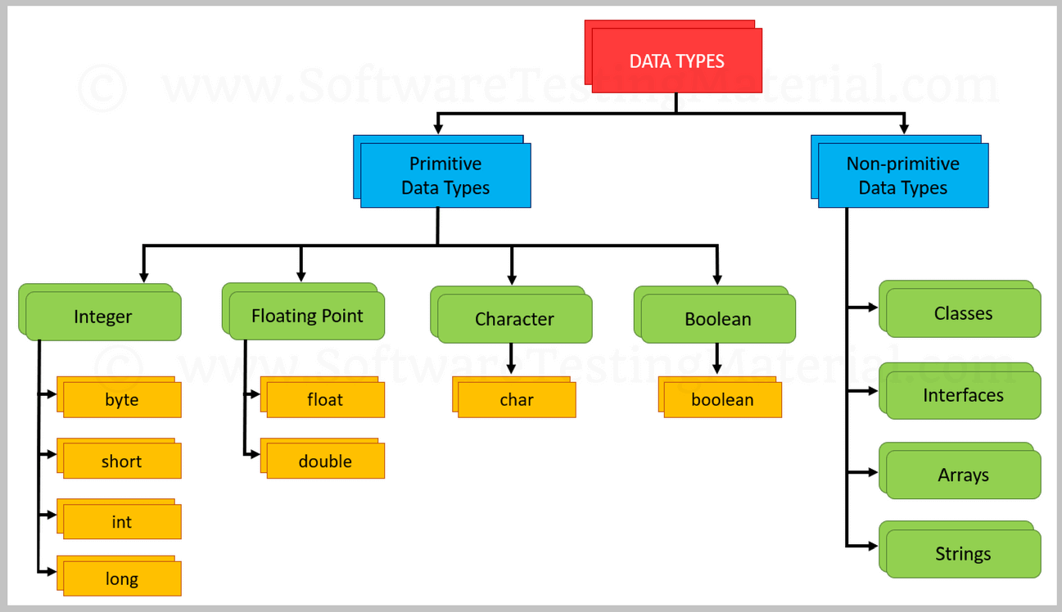

Slide 30
Primitive Data types
Primitive Data Type | Size | Details
byte | 1 byte | Stores positive and negative numbers ranging from -128 to 127.
int | 4 bytes | Stores positive and negative numbers ranging from -2,147,483,648 to 2,147,483,647.
short | 2 bytes | Stores positive and negative numbers ranging from -32,768 to 32,767.
long | 8 bytes | Stores positive and negative numbers from -9,223,372,036,854,775,808 to 9,223,372,036,854,775,807.
The primitive data types are the predefined data types. They specify the size and type of any standard values. The main primitive data types namely byte, short, int, long, float, double, char and boolean.

Slide 31
Primitive Data Type | Size | Details
float | 4 bytes | Stores Decimal numbers. It can be used for storing numbers having 6 to 7 decimal digits
double | 8 bytes | Stores Decimal numbers. It can be used for storing numbers having 15 decimal digits.
boolean | 1 bit | Can Store Only true or false.
char | 2 bytes | It can be used for storing only a single character, letter or ASCII values.

Slide 32
Boolean: Represents a binary value of either true or false. Size: 1 byte.
Byte: Represents an unsigned 8-bit integer value. Range: 0 to 255. Size: 1 byte.
SByte: Represents a signed 8-bit integer value. Range: -128 to 127. Size: 1 byte.
Int16: Represents a signed 16-bit integer value. Range: -32768 to 32767. Size: 2 bytes.
UInt16: Represents an unsigned 16-bit integer value. Range: 0 to 65535. Size: 2 bytes.
Int32: Represents a signed 32-bit integer value. Range: -2147483648 to 2147483647. Size: 4 bytes.
UInt32: Represents an unsigned 32-bit integer value. Range: 0 to 4294967295. Size: 4 bytes.

Slide 33
Int64: Represents a signed 64-bit integer value. Range: -9223372036854775808 to 9223372036854775807. Size: 8 bytes.
UInt64: Represents an unsigned 64-bit integer value. Range: 0 to 18446744073709551615. Size: 8 bytes.
Char: Represents a single Unicode character. Size: 2 bytes.
Float: Represents a single-precision floating-point number. Range: approximately 1.5 x 10^-45 to 3.4 x 10^38. Size: 4 bytes.
Double: Represents a double-precision floating-point number. Range: approximately 5.0 x 10^-324 to 1.7 x 10^308. Size: 8 bytes.
Decimal: Represents a decimal floating-point number. Range: approximately (-7.9 x 10^28 to 7.9 x 10^28) / 10^0 to 28. Size: 16 bytes.

Slide 34
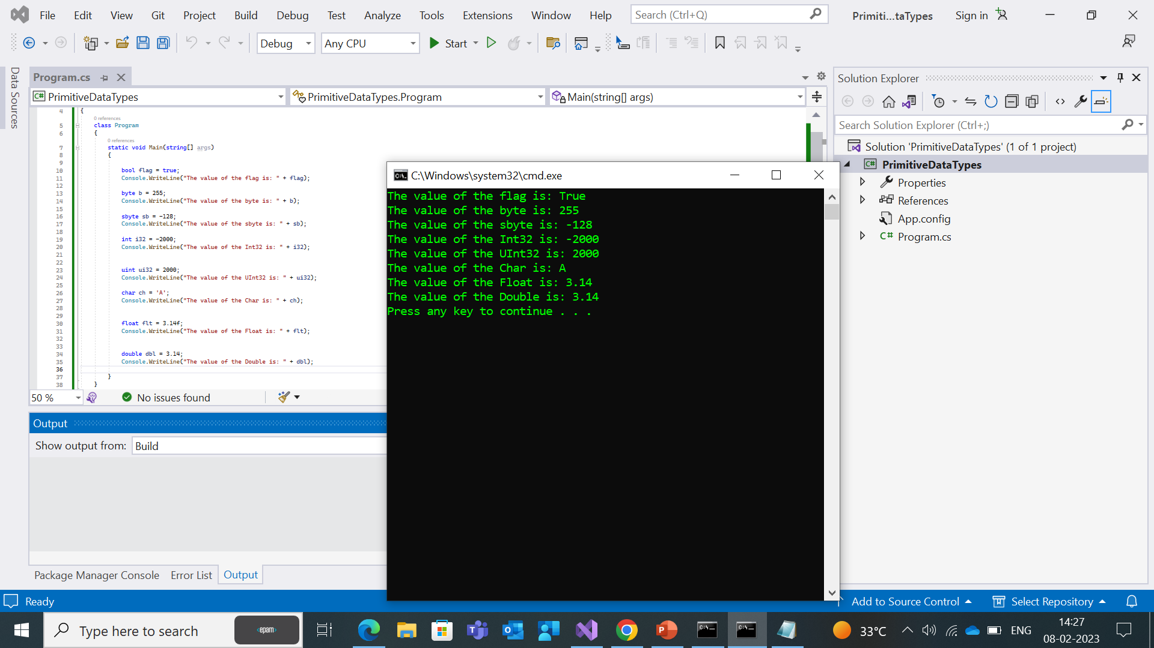

Slide 35
Non-Primitive Data Types
Non-Primitive data types refer to objects and hence they are called reference types. Examples of non-primitive types include Strings, Arrays, Classes, Interface, etc.
Non-Primitive data types are user defined.
when we declare a non-primitive reference variable, the variable only stores a reference of the memory location where the object is stored.
The default value of non-primitive reference variables is null.

Slide 36
Collections
In .NET, collections are data structures that allow you to store and manipulate groups of related objects.
These are mainly categorized into 3.
1.Generic collections.
2.Non-Generic collections.
3.Concurrent collections.

Slide 37
Generic Collections
Generic collections are those that are parameterized by the type of objects they can store, such as List<T> or Dictionary<TKey, TValue>. These collections provide strong type-safety, better performance, and improved code readability.
The namespace for generic collections in .NET is using.System.Collections.Generic
In C#, the .NET framework provides several generic collection classes, including:
List<T>: A dynamic array that can grow as new elements are added.
Dictionary<TKey, TValue>: A collection of key-value pairs where each key must be unique.

Slide 38
HashSet<T>: A collection of unique elements without any key-value association.
Stack<T>: A collection that implements a last-in-first-out (LIFO) strategy for adding and removing elements.
Queue<T>: A collection that implements a first-in-first-out (FIFO) strategy for adding and removing elements.
SortedList<Tkey,Tvalue>:Represents a collection of key/value pairs that are sorted by key.
LinkedList<T>:It allows fast inserting and removing of elements which implements a classic linked list.
Each of these collections provides methods for adding, removing, searching, and sorting elements, as well as other operations specific to the type of collection.

Slide 39
List<T>
List<T> is a generic data structure in C# that allows you to store a collection of elements of a specific type, and provides various methods for manipulating the list. Here are some of the most commonly used methods in List<T>:
Add(item): Adds an item to the end of the list.
RemoveAt(index): Removes the item at the specified index from the list.
Clear(): Removes all items from the list.
Contains(item): Returns a boolean value indicating whether the list contains the specified item.
IndexOf(item): Returns the index of the first occurrence of the specified item in the list.
Sort(): Sorts the elements in the list using the default comparer for the element type.
Reverse(): Reverses the order of the elements in the list.
ToArray(): Copies the list to a new array.
These are some of the most commonly used methods in List<T> in C#.

Slide 40
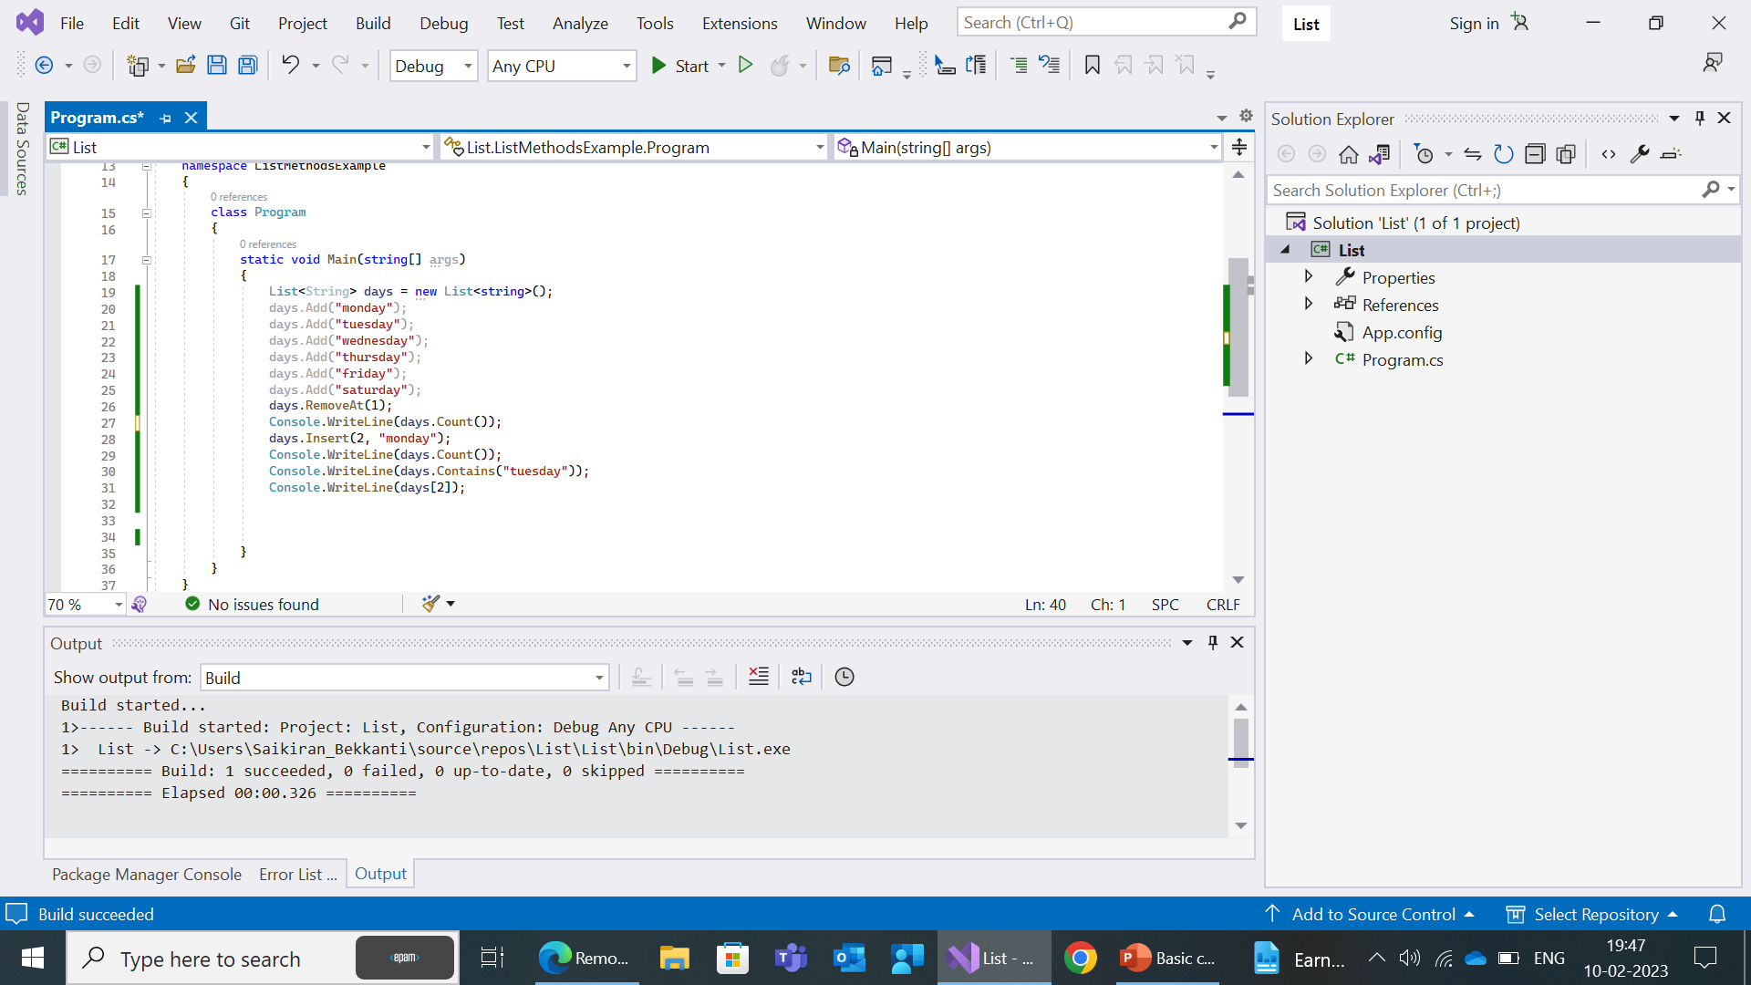
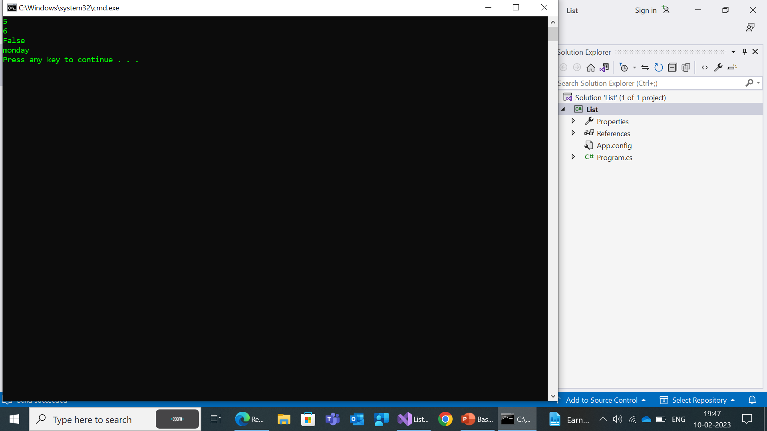

Slide 41
Dictionary
The Dictionary<TKey, TValue> class in C# represents a collection of key-value pairs, where each key must be unique.
The type of the keys and values are specified when the dictionary is created and can be any data type, such as integers, strings, or custom classes.
Duplicate keys are not allowed if you try to use duplicate key then compiler will throw an exception.
In dictionary the capacity will it be based on the number of elements that dictionary can hold.
It is dynamic in nature

Slide 42
Methods
Add(TKey key, TValue value): Adds a new key-value pair to the dictionary. If the specified key already exists in the dictionary, an exception is thrown.
Remove(TKey key): Removes the key-value pair with the specified key from the dictionary.
ContainsKey(TKey key): Returns a Boolean value indicating whether the specified key exists in the dictionary.
Clear(): Removes all key-value pairs from the dictionary.
Count: Gets the number of key-value pairs in the dictionary.
Keys: Gets a collection containing all the keys in the dictionary.
Values: Gets a collection containing all the values in the dictionary.

Slide 43
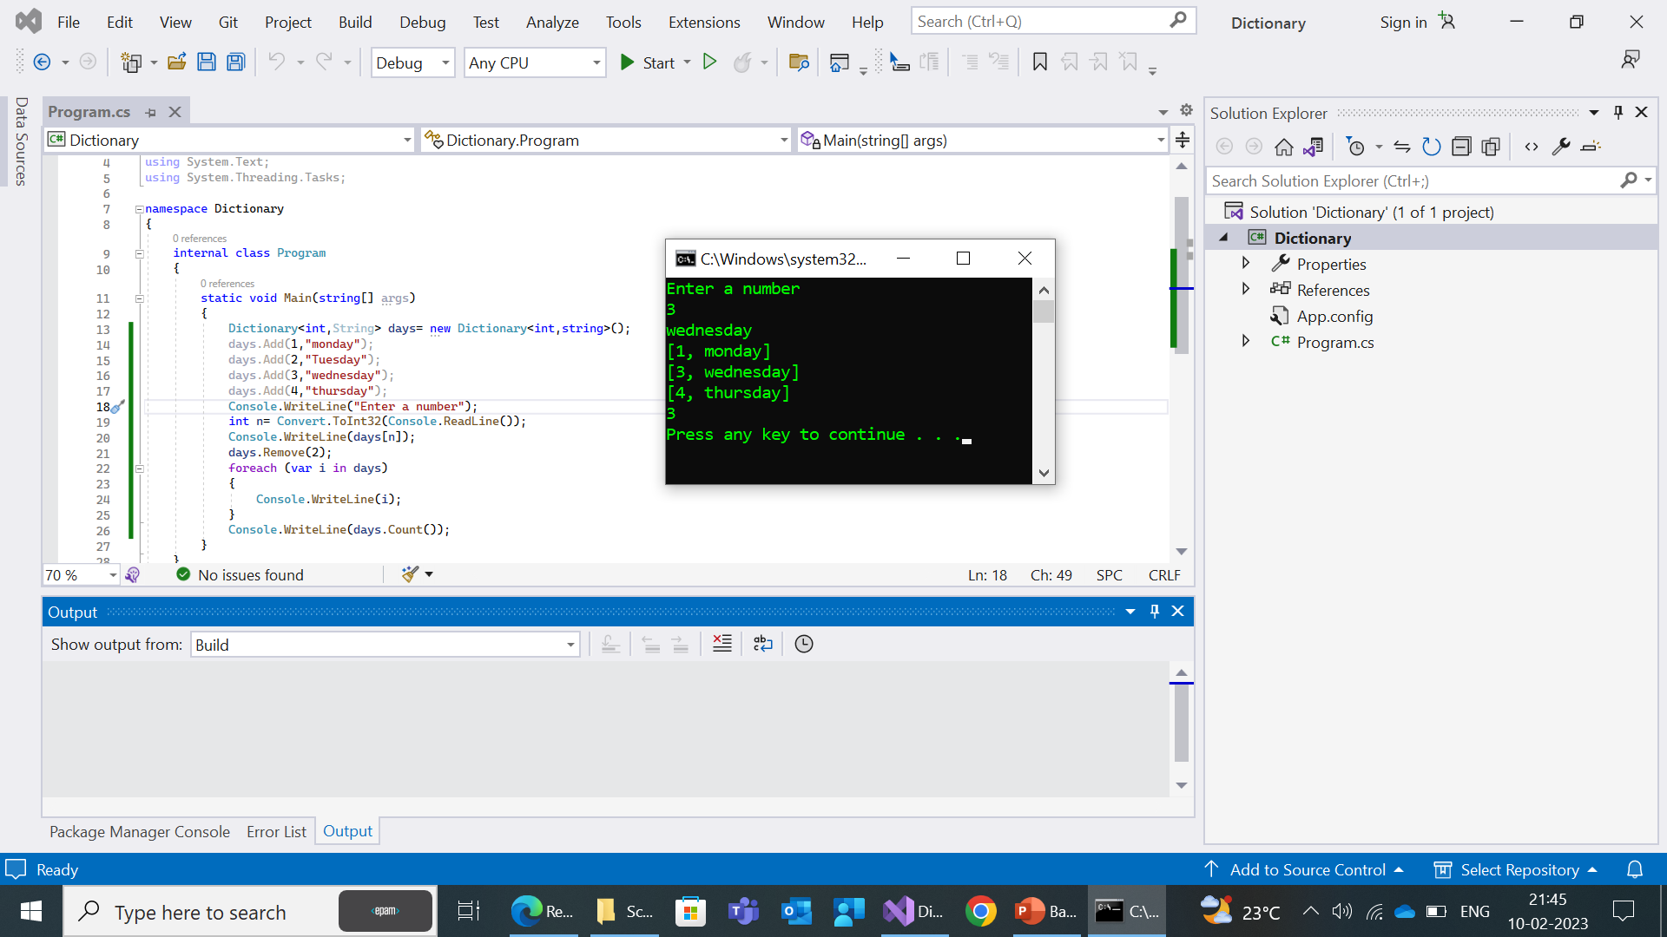

Slide 44
HashSet
HashSet<T> is a generic data structure in C# that allows you to store a collection of unique elements of a specific type, and provides various methods for manipulating the set.It doesn’t allow duplicate values.
Here are some of the most commonly used methods in HashSet<T>:
Add(item): Adds an item to the set. If the item already exists in the set, it will not be added again.
Remove(item): Removes the specified item from the set.
Clear(): Removes all items from the set.
Contains(item): Returns a boolean value indicating whether the set contains the specified item.

Slide 45
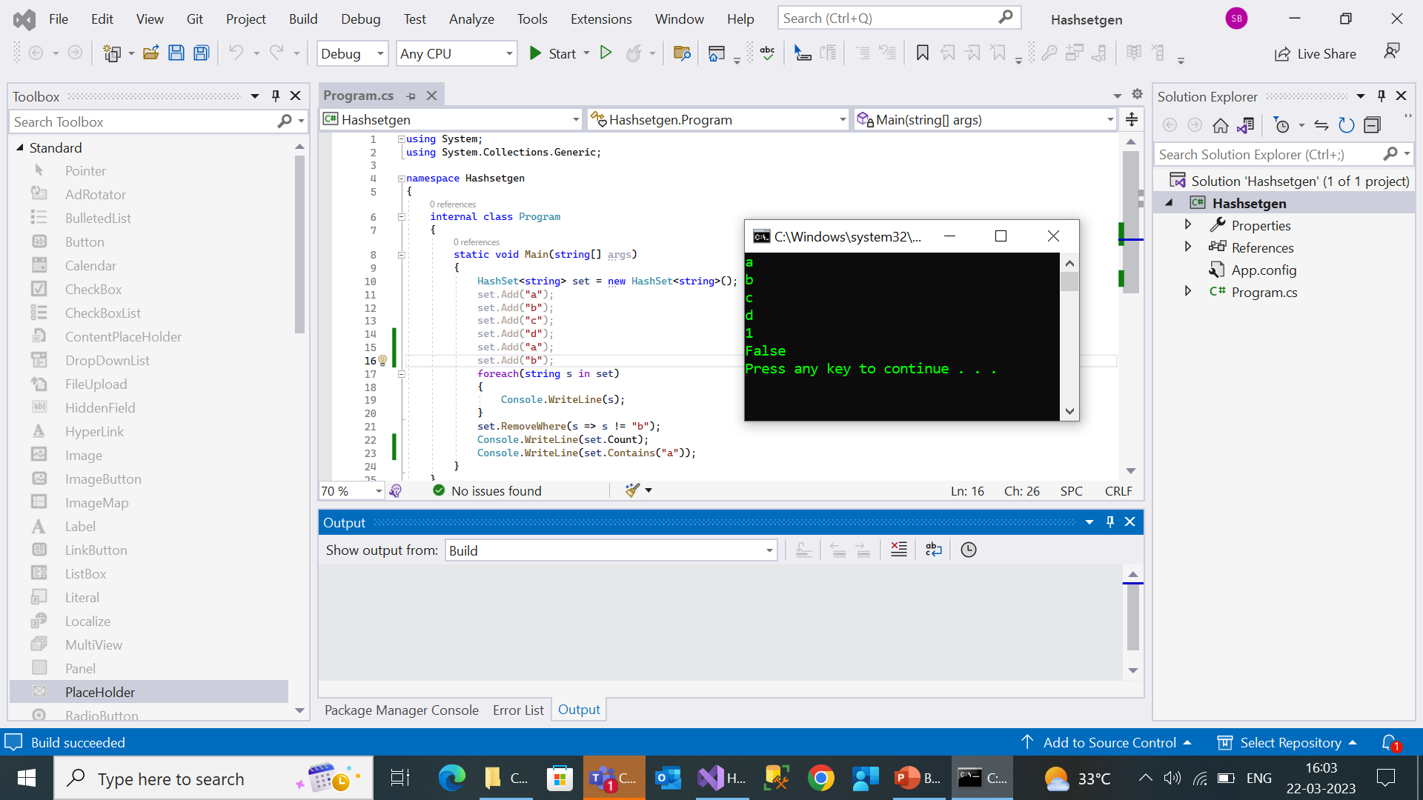

Slide 46
Stack<T>
Stack<T> is a generic data structure in C# that implements a Last-In-First-Out (LIFO) data structure. Here are some of the most commonly used methods in Stack<T>:
Push(item): Adds an item to the top of the Stack.
Pop(): Removes and returns the item at the top of the Stack.
Peek(): Returns the item at the top of the Stack without removing it.
Clear(): Removes all items from the Stack.
Contains(item): Returns a boolean value indicating whether the Stack contains the specified item.
ToArray(): Copies the Stack to a new array.
TrimExcess(): Sets the capacity of the Stack to the actual number of elements it contains, reducing the amount of memory used by the Stack.
These are some of the most commonly used methods in Stack<T> in C#

Slide 47
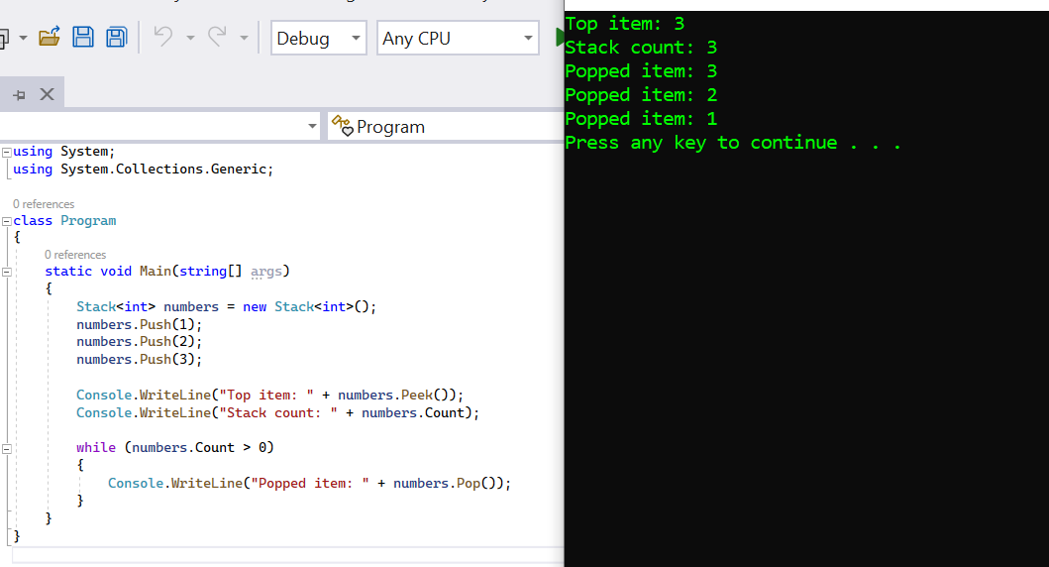

Slide 48
Queue<T>
Queue<T> is a generic data structure in C# that implements a First-In-First-Out (FIFO) data structure. Here are some of the most commonly used methods in Queue<T>:
Enqueue(item): Adds an item to the end of the Queue.
Dequeue(): Removes and returns the item at the front of the Queue.
Peek(): Returns the item at the front of the Queue without removing it.
Clear(): Removes all items from the Queue.
Contains(item): Returns a boolean value indicating whether the Queue contains the specified item.
These are some of the most commonly used methods in Queue<T> in C#.

Slide 49
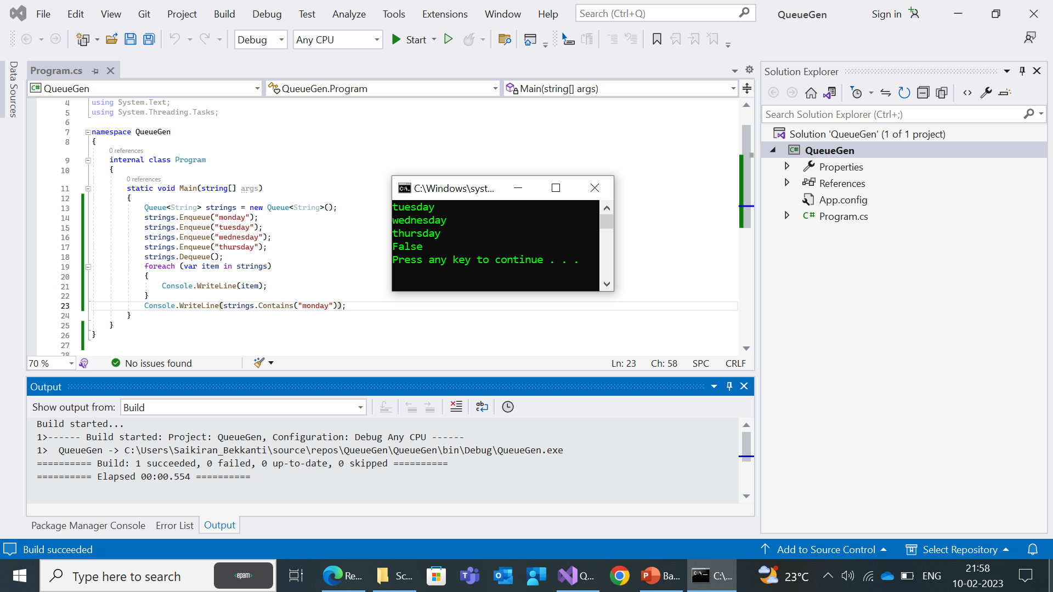

Slide 50
SortedList<T>
SortedList<TKey, TValue> is a generic collection in C# that implemented as a sorted list of key value pairs,where the keys are sorted in ascending order.Here are some of the most commonly used methods in SortedList<TKey, TValue>:
Add(TKey key, TValue value): Adds an item to the SortedList with the specified key and value.
Remove(TKey key): Removes the item with the specified key from the SortedList.
ContainsKey(TKey key): Returns a boolean value indicating whether the SortedList contains an item with the specified key.
ContainsValue(TValue value): Returns a boolean value indicating whether the SortedList contains the specified value.
Clear(): Removes all items from the SortedList.
Keys: Gets a collection containing all the keys in the SortedList.
Values: Gets a collection containing all the values in the SortedList.
IndexOfKey(TKey key): Gets the index of the item with the specified key in the SortedList.

Slide 51
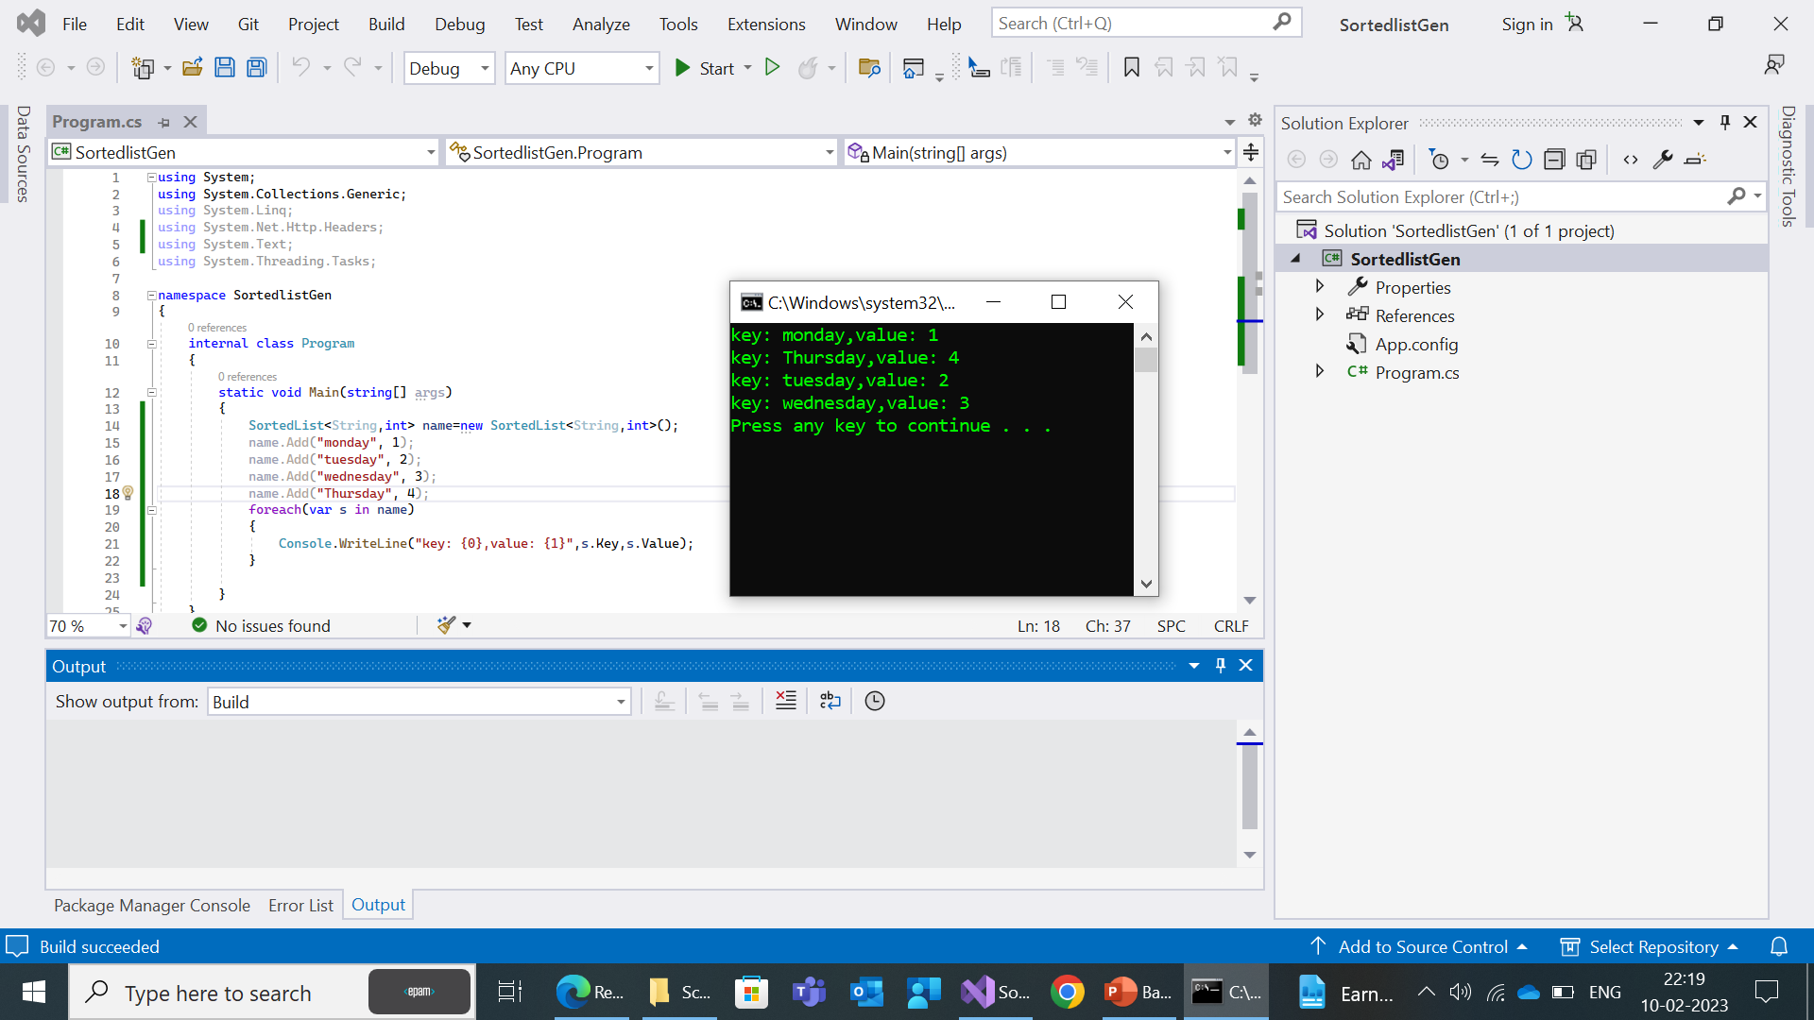

Slide 52
LinkedList<T>
LinkedList<T> is a generic data structure in C# that implements a linked list data structure. Here are some of the most commonly used methods in LinkedList<T>:
AddFirst(T value): Adds a new node with the specified value to the beginning of the LinkedList.
AddLast(T value): Adds a new node with the specified value to the end of the LinkedList.
RemoveFirst(): Removes the first node in the LinkedList.
RemoveLast(): Removes the last node in the LinkedList.
AddBefore(LinkedListNode<T> node, T value): Adds a new node with the specified value before the specified node in the LinkedList.
AddAfter(LinkedListNode<T> node, T value): Adds a new node with the specified value after the specified node in the LinkedList.

Slide 53
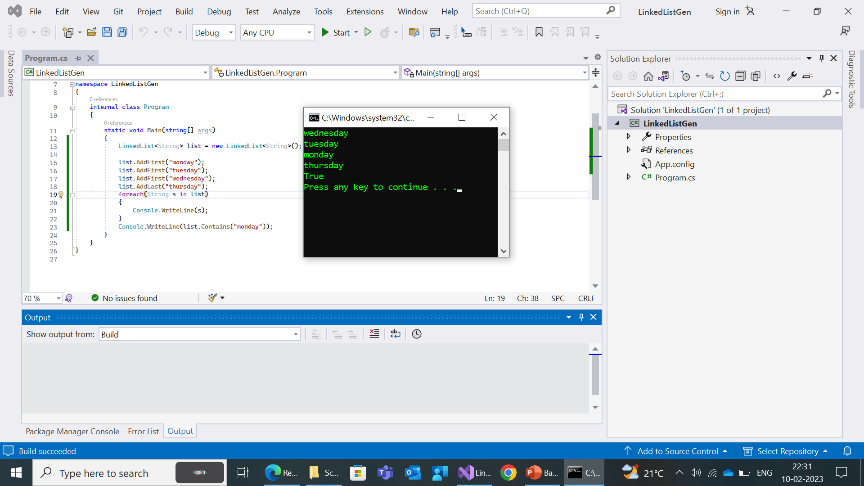

Slide 54
Non-Generic Collections
Non-generic collections: do not use a type parameter and instead store elements as objects.
For example, the ArrayList class is a non-generic collection.
The ArrayList class in C# is a non-generic collection that provides dynamic array-like behavior. The ArrayList class provides a variety of methods for adding, removing, and manipulating elements.
The namespace for generic collections in .NET is using.System.Collections

Slide 55
Methods :
add(element): Adds an element to the end of the list.
remove(element): Removes the first occurrence of the specified element from the list.
set(index, element): Replaces the element at the specified index with the given element.
get(index): Returns the element at the specified index in the list.
size(): Returns the number of elements in the list.
clear(): Removes all elements from the list.
isEmpty(): Returns a boolean value indicating whether the list is empty or not.
sort(): Sorts the elements in the list in their natural order.

Slide 56
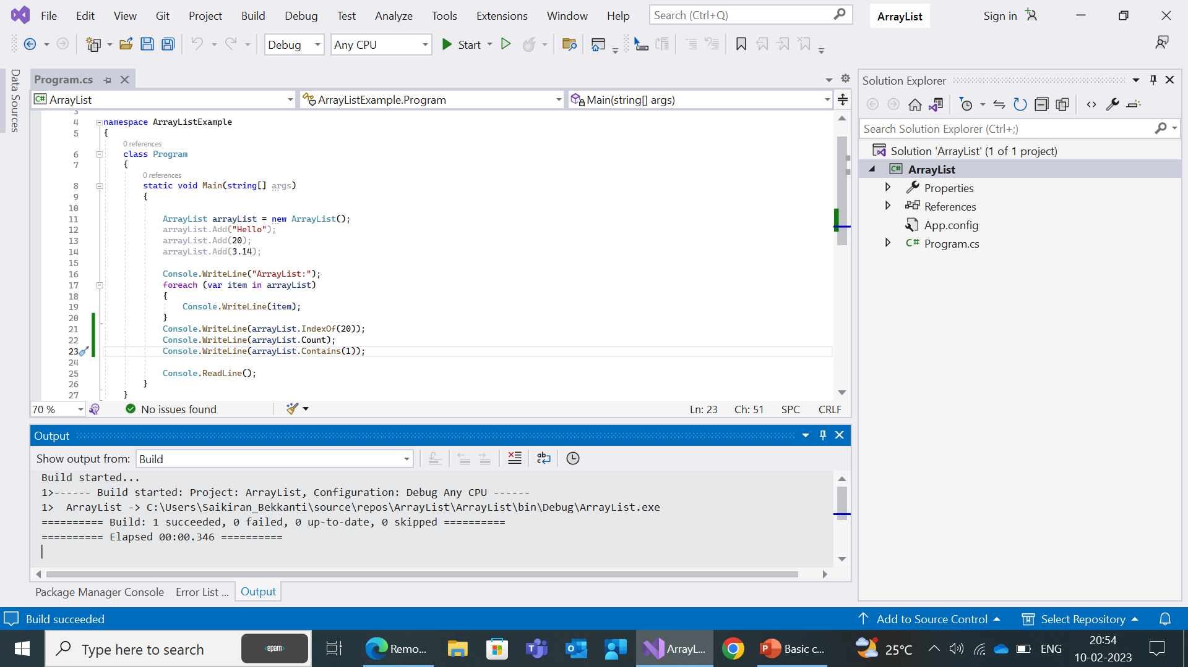


Slide 57
HASH TABLE
A hashtable is a collection of key/value pairs that are arranged based on the hash code of the key.
It is a non generic type of collection which is defined in system dot collections namespace.
In hash table the key cannot be null but value can be.
Methods
Add(key, value): Adds a key-value pair to the Hashtable.
Remove(key): Removes the key-value pair associated with the specified key.
ContainsKey(key): Returns a boolean value indicating whether the Hashtable contains a key-value pair with the specified key.
ContainsValue(value): Returns a boolean value indicating whether the Hashtable contains
Keys: Gets a collection of all the keys in the Hashtable.
Values: Gets a collection of all the values in the Hashtable.
Count: Gets the number of key-value pairs in the Hashtable.

Slide 58
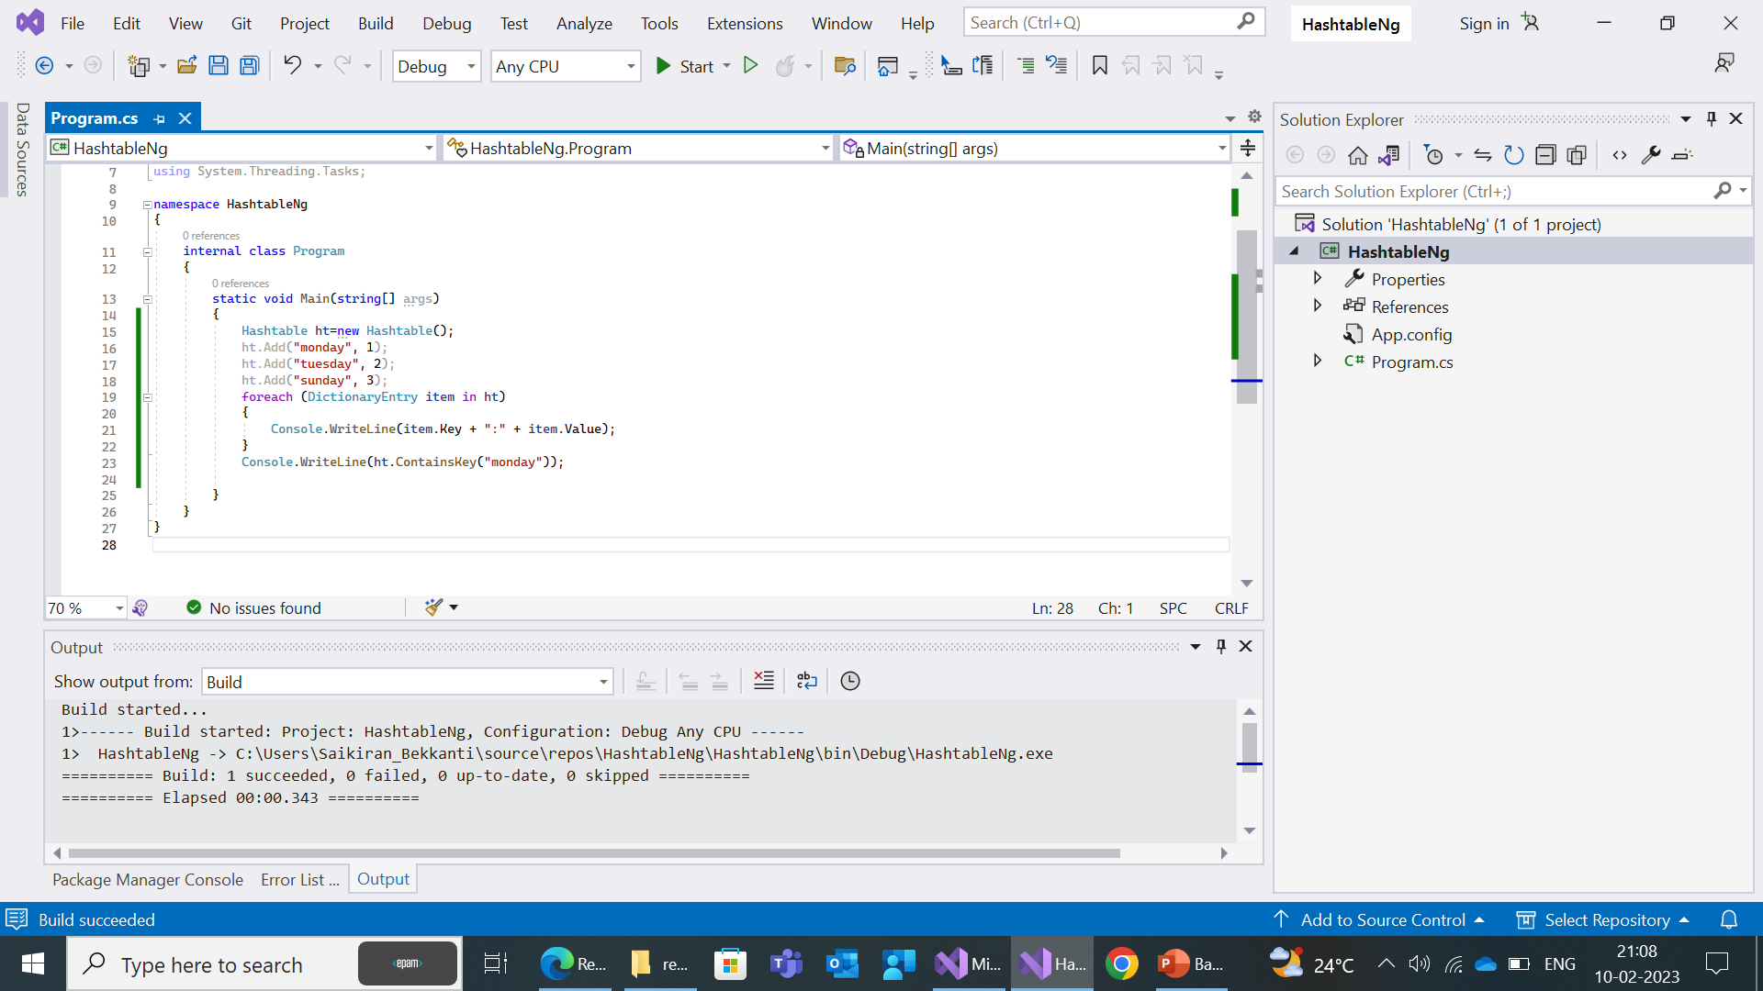


Slide 59
Queue
Queue is a data structure in C# that implements a First-In-First-Out (FIFO) data structure. Here are some of the most commonly used methods in Queue:
Enqueue(item): Adds an item to the end of the Queue.
Dequeue(): Removes and returns the item at the beginning of the Queue.
Peek(): Returns the item at the beginning of the Queue without removing it.
Clear(): Removes all items from the Queue.
Contains(item): Returns a boolean value indicating whether the Queue contains the specified item.
ToArray(): Copies the Queue to a new array.
These are some of the most commonly used methods in Queue in C#.

Slide 60
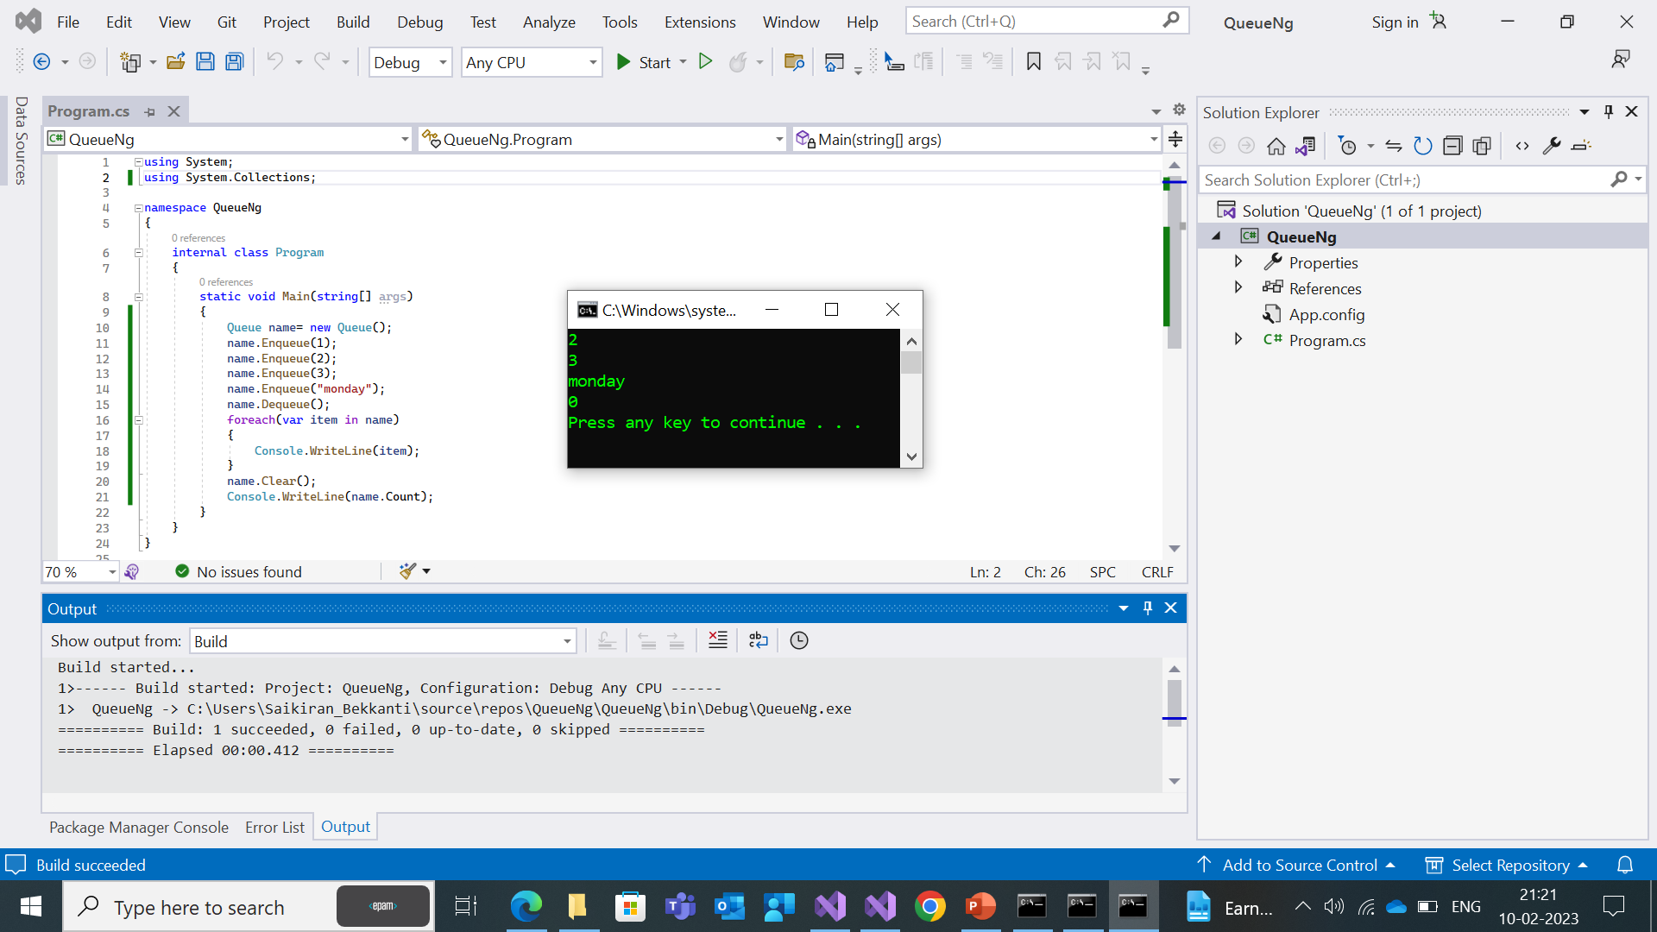

Slide 61
Stack
Stack is a data structure in C# that implements a Last-In-First-Out (LIFO) data structure. Here are some of the most commonly used methods in Stack:
Push(item): Adds an item to the top of the Stack.
Pop(): Removes and returns the item at the top of the Stack.
Peek(): Returns the item at the top of the Stack without removing it.
Clear(): Removes all items from the Stack.
Contains(item): Returns a boolean value indicating whether the Stack contains the specified item.
ToArray(): Copies the Stack to a new array.
TrimExcess(): Sets the capacity of the Stack to the actual number of elements it contains, reducing the amount of memory used by the Stack.
These are some of the most commonly used methods in Stack in C#.

Slide 62
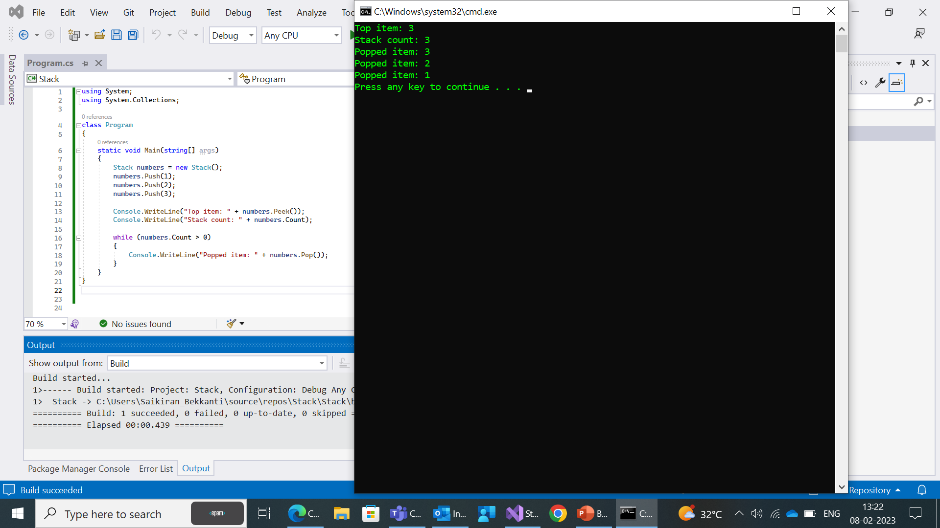

Slide 63
Concurrent Collections
Concurrent collections in C# are collections designed for use in multithreaded environments. They provide a way to safely access and modify collections from multiple threads without the need for locks or other synchronization mechanisms. Here are some of the commonly used concurrent collections in C#:
ConcurrentQueue<T>: A thread-safe, first-in-first-out (FIFO) queue.
ConcurrentStack<T>: A thread-safe, last-in-first-out (LIFO) stack.
ConcurrentDictionary<TKey, TValue>: A thread-safe dictionary that supports concurrent access and modification.
BlockingCollection<T>: A thread-safe collection that provides blocking operations, allowing you to wait for items to become available or for the collection to become full.
ConcurrentBag<T>: A thread-safe, unordered collection that supports concurrent additions and removals.
These are some of the commonly used concurrent collections in C#.

Slide 64
ConcurrentQueue<T>
ConcurrentQueue<T> is a thread-safe, first-in-first-out (FIFO) queue in C#. Here are some of the commonly used methods in ConcurrentQueue<T>:
Enqueue(T item): Adds an item to the end of the queue.
TryDequeue(out T result): Attempts to remove and return the item at the beginning of the queue.
TryPeek(out T result): Attempts to return the item at the beginning of the queue without removing it.
IsEmpty: Returns a boolean value indicating whether the queue is empty.
Count: Returns the number of items in the queue.
These are some of the commonly used methods in ConcurrentQueue<T>.

Slide 65
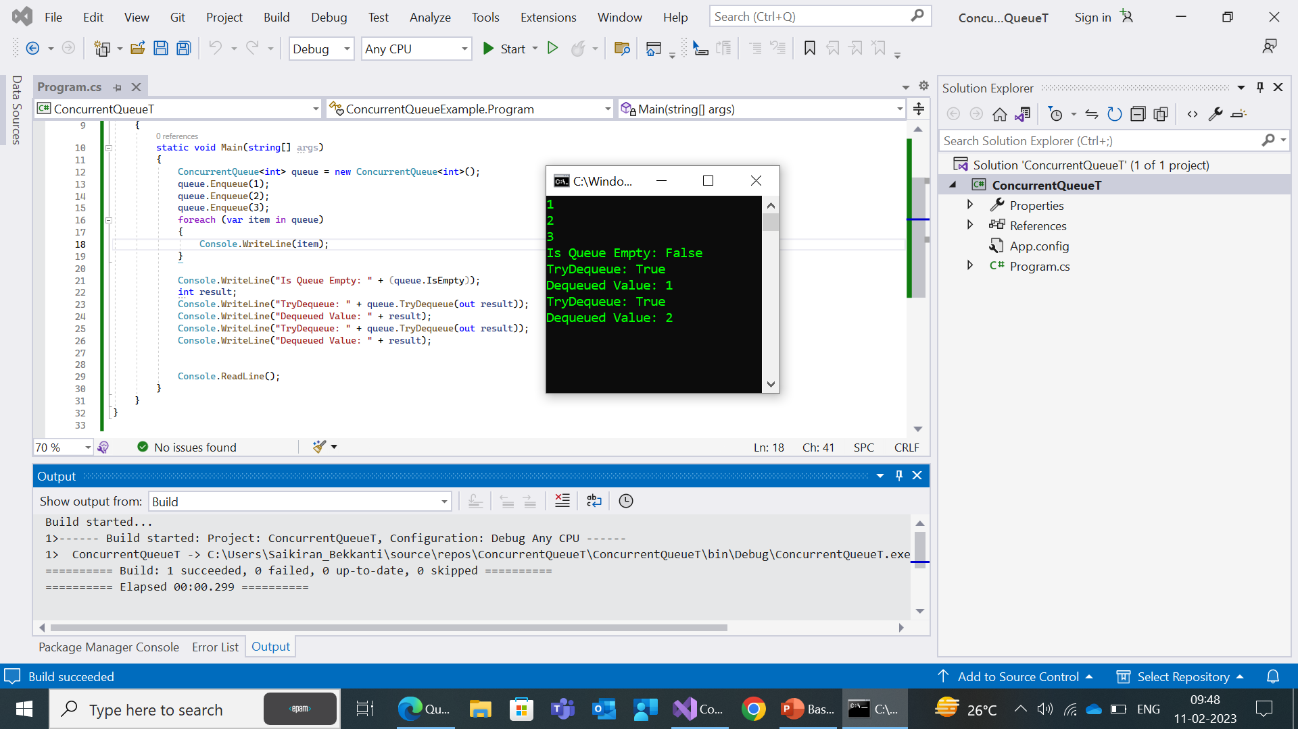

Slide 66
ConcurrentStack<T>
ConcurrentStack<T> is a thread-safe, last-in-first-out (LIFO) stack in C#. Here are some of the commonly used methods in ConcurrentStack<T>:
Push(T item): Adds an item to the top of the stack.
TryPop(out T result): Attempts to remove and return the item at the top of the stack.
TryPeek(out T result): Attempts to return the item at the top of the stack without removing it.
IsEmpty: Returns a boolean value indicating whether the stack is empty.
Count: Returns the number of items in the stack.
These are some of the commonly used methods in ConcurrentStack<T>.

Slide 67
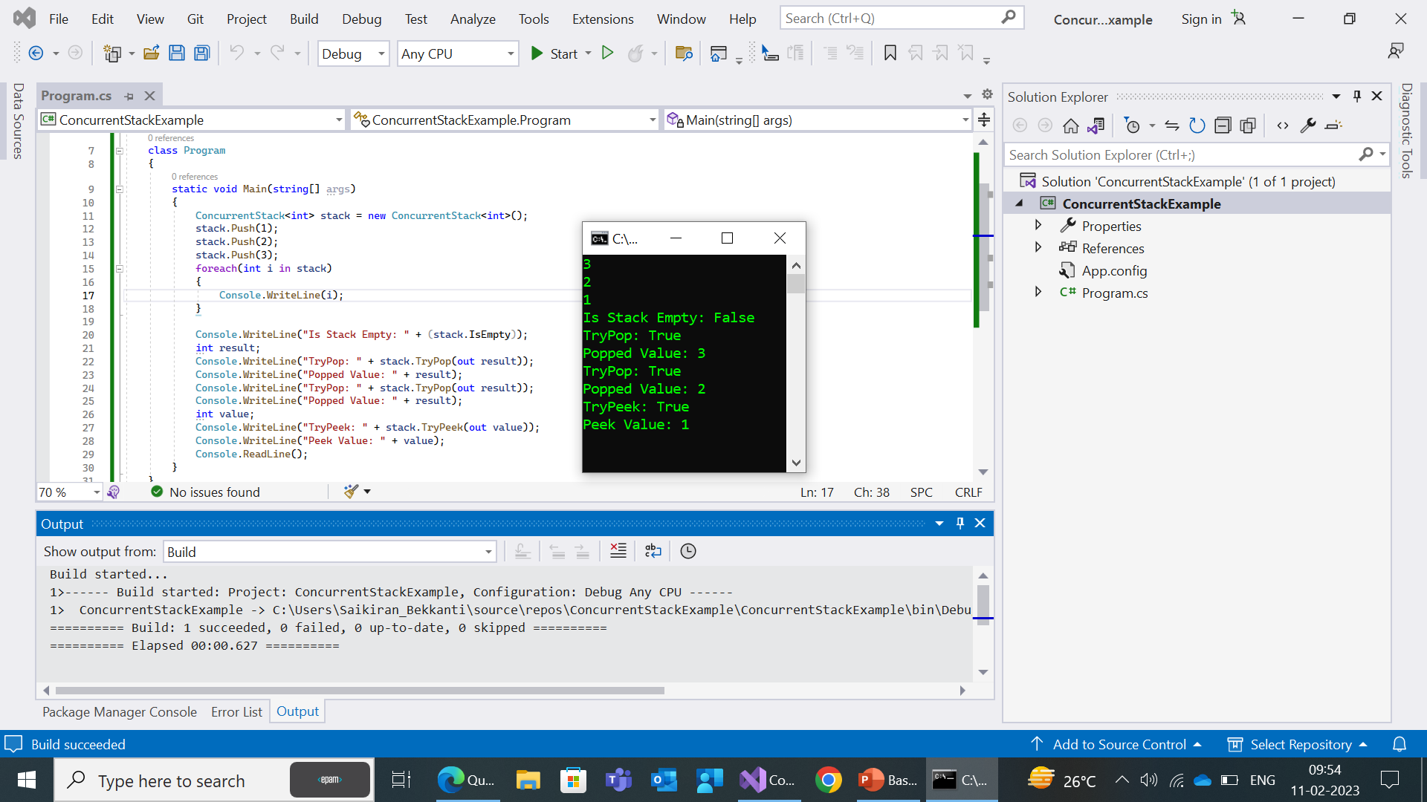

Slide 68
ConcurrentDictionary<T>
ConcurrentDictionary<TKey, TValue> is a thread-safe dictionary in C# that supports concurrent access and modification. Here are some of the commonly used methods in ConcurrentDictionary<TKey, TValue>:
AddOrUpdate(TKey key, TValue addValue, Func<TKey, TValue, TValue> updateValueFactory): Adds a key/value pair to the dictionary if the key does not already exist, or updates the value associated with the key if the key already exists.
TryAdd(TKey key, TValue value): Attempts to add a key/value pair to the dictionary.
TryGetValue(TKey key, out TValue value): Attempts to retrieve the value associated with the specified key.
TryRemove(TKey key, out TValue value): Attempts to remove the key/value pair associated with the specified key.
ContainsKey(TKey key): Returns a boolean value indicating whether the specified key is present in the dictionary.
Count: Returns the number of key/value pairs in the dictionary.

Slide 69
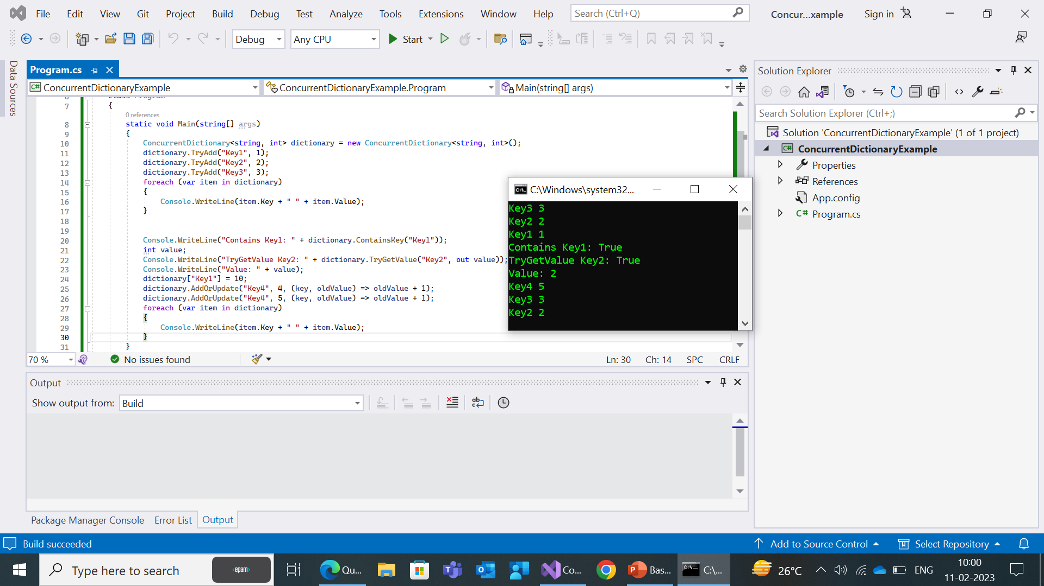

Slide 70
Blocking Collections<T>
BlockingCollection<T> is a thread-safe collection in C# that provides a convenient way to implement producer-consumer patterns in multithreaded environments. Here are some of the commonly used methods in BlockingCollection<T>:
Add(T item): Adds an item to the collection.
TryTake(out T item, int millisecondsTimeout): Attempts to remove and return an item from the collection. If the collection is empty, the calling thread will block until an item is available or the specified timeout has elapsed.
CompleteAdding(): Signals to the collection that no more items will be added.
IsCompleted: Returns a boolean value indicating whether the collection is in a completed state.
Count: Returns the number of items in the collection.
These are some of the commonly used methods in BlockingCollection<T>.

Slide 71
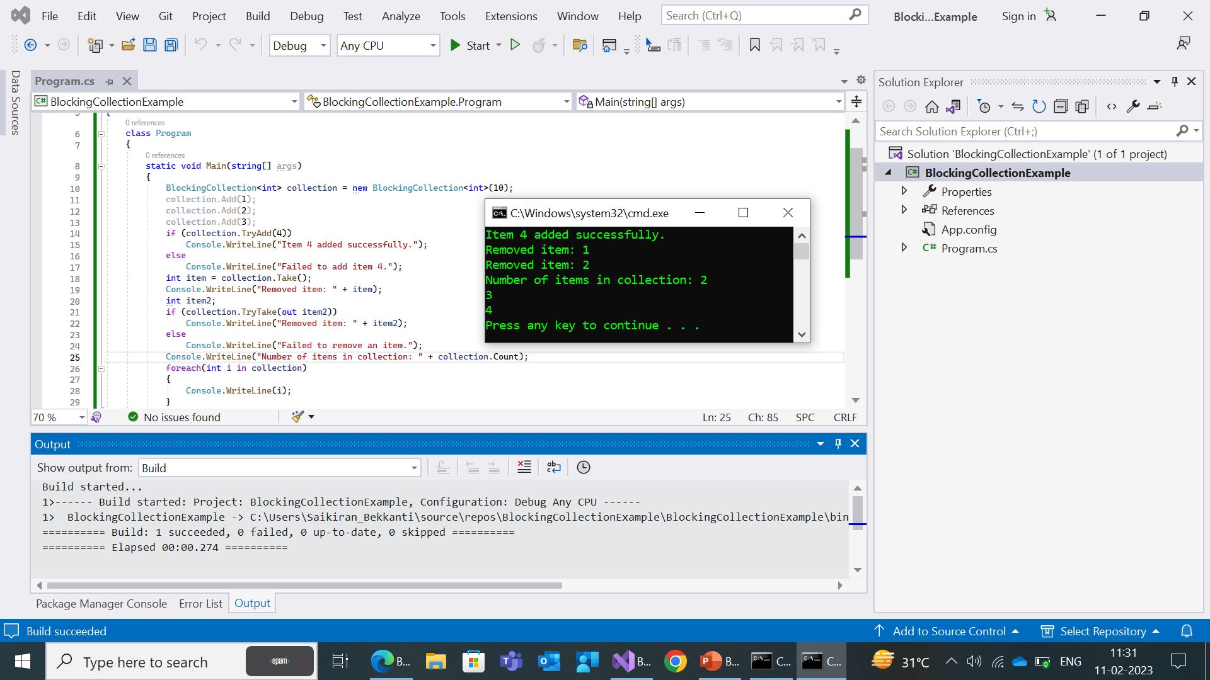

Slide 72
ConcurrentBag<T>
ConcurrentBag<T> is a thread-safe collection in C# that provides a convenient way to store and retrieve items in a random order. Here are some of the commonly used methods in ConcurrentBag<T>:
Add(T item): Adds an item to the bag.
TryTake(out T item): Attempts to remove and return an item from the bag.
TryPeek(out T item): Attempts to return an item from the bag without removing it.
IsEmpty: Returns a boolean value indicating whether the bag is empty.
Count: Returns the number of items in the bag.
These are some of the commonly used methods in ConcurrentBag<T>.

Slide 73
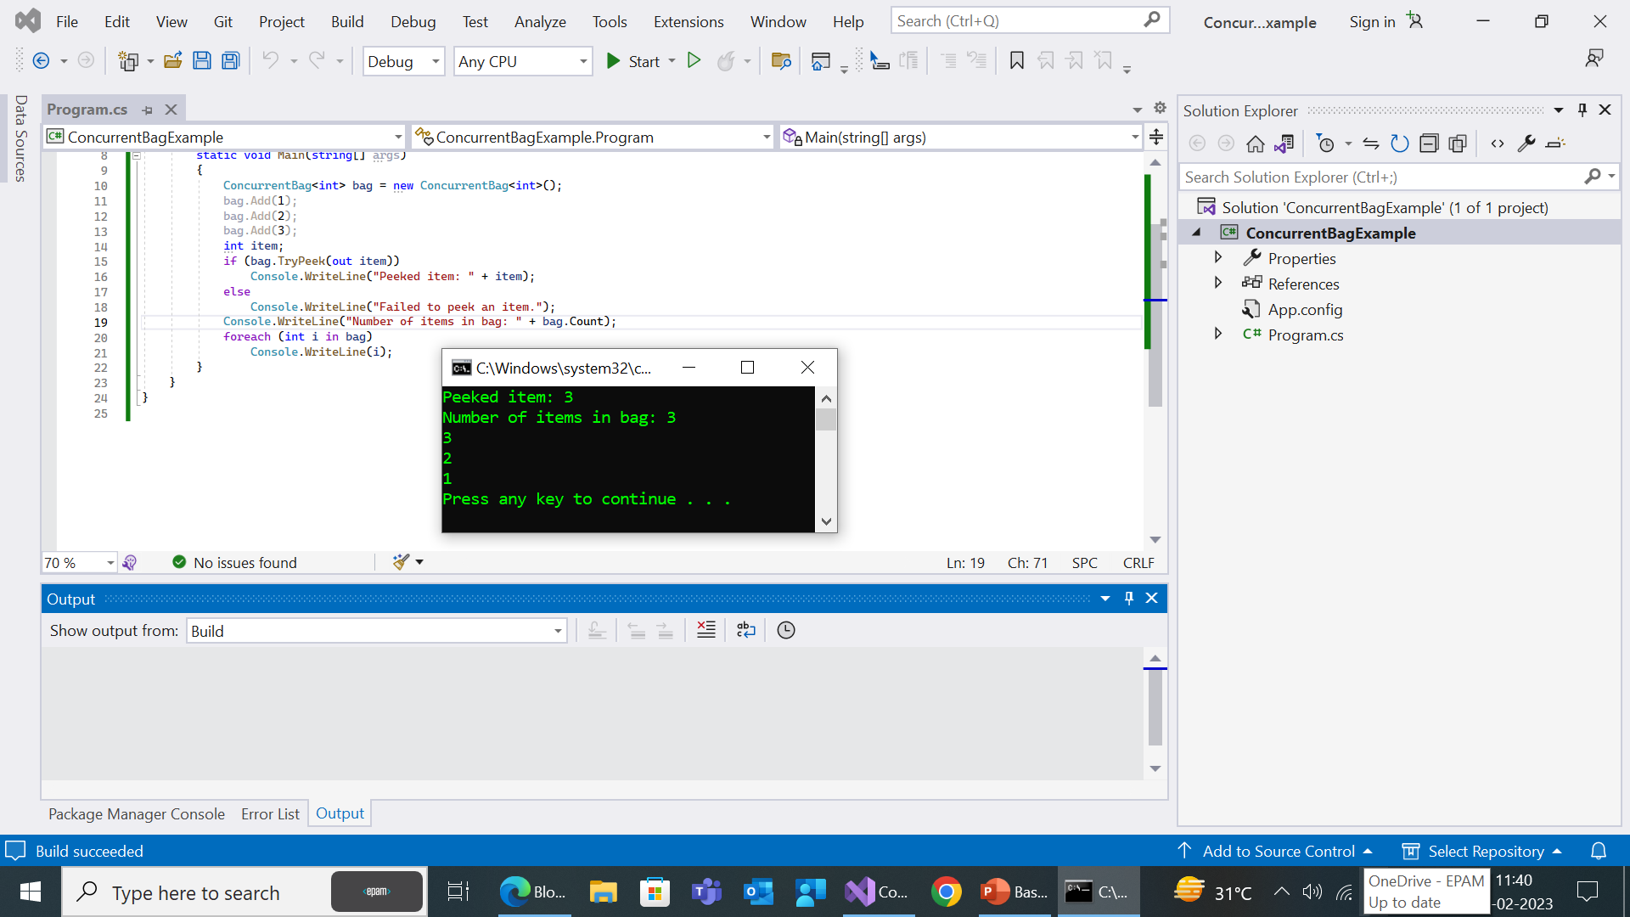

Slide 74
Object Model Collections
The System.Collections.ObjectModel namespace in C# provides several classes that are commonly used to implement custom collections. Some of these classes are:
Collection<T>:
This is a generic collection that provides a base class for creating your own collection classes. It provides methods for adding, removing, and accessing items in the collection.
Add: Adds an item to the collection.
Remove: Removes the first occurrence of a specific object from the collection.
Clear: Removes all items from the collection.
.

Slide 75
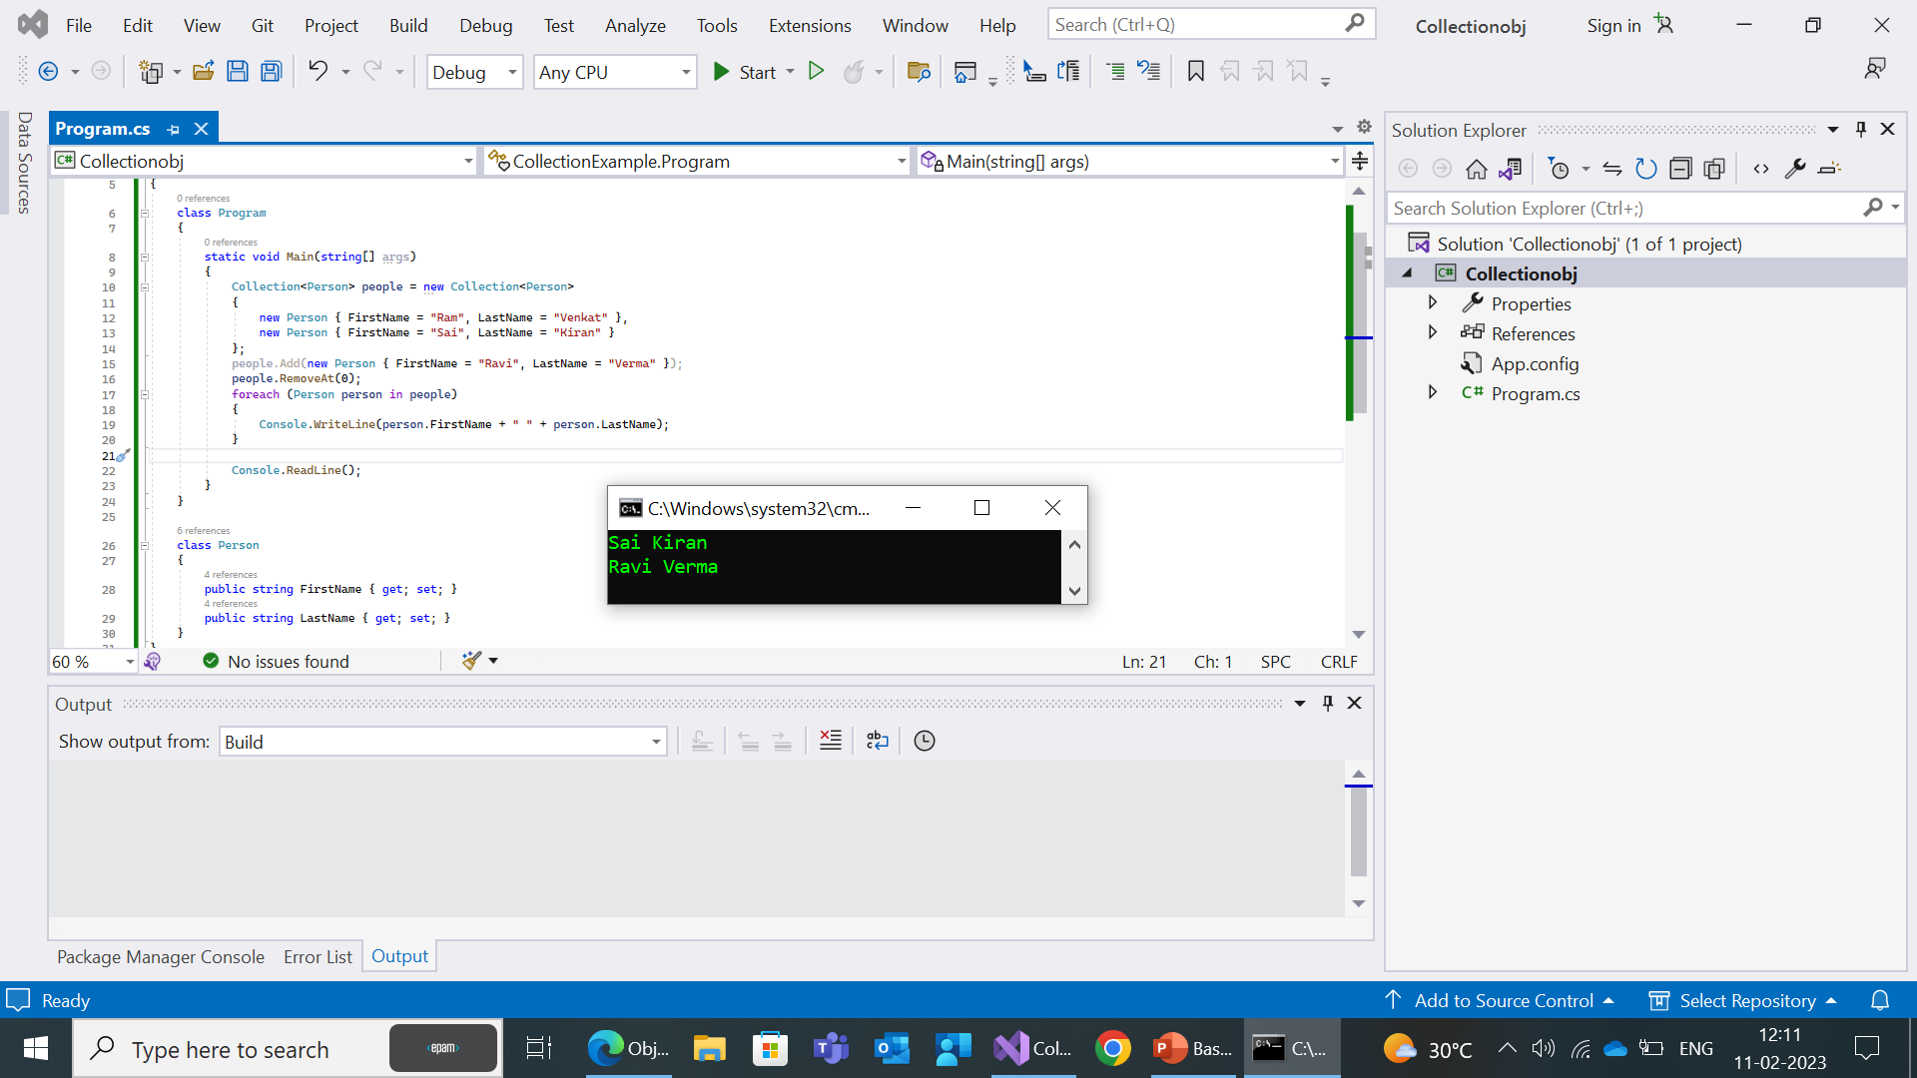

Slide 76
ObservableCollection
This is a dynamic data collection that provides notifications when items get added, removed, or when the whole list is refreshed.
This class is often used in data binding scenarios, where the user interface needs to be updated whenever the underlying data changes.
Add: Adds an item to the collection.
Remove: Removes the first occurrence of a specific object from the collection.
Clear: Removes all items from the collection

Slide 77
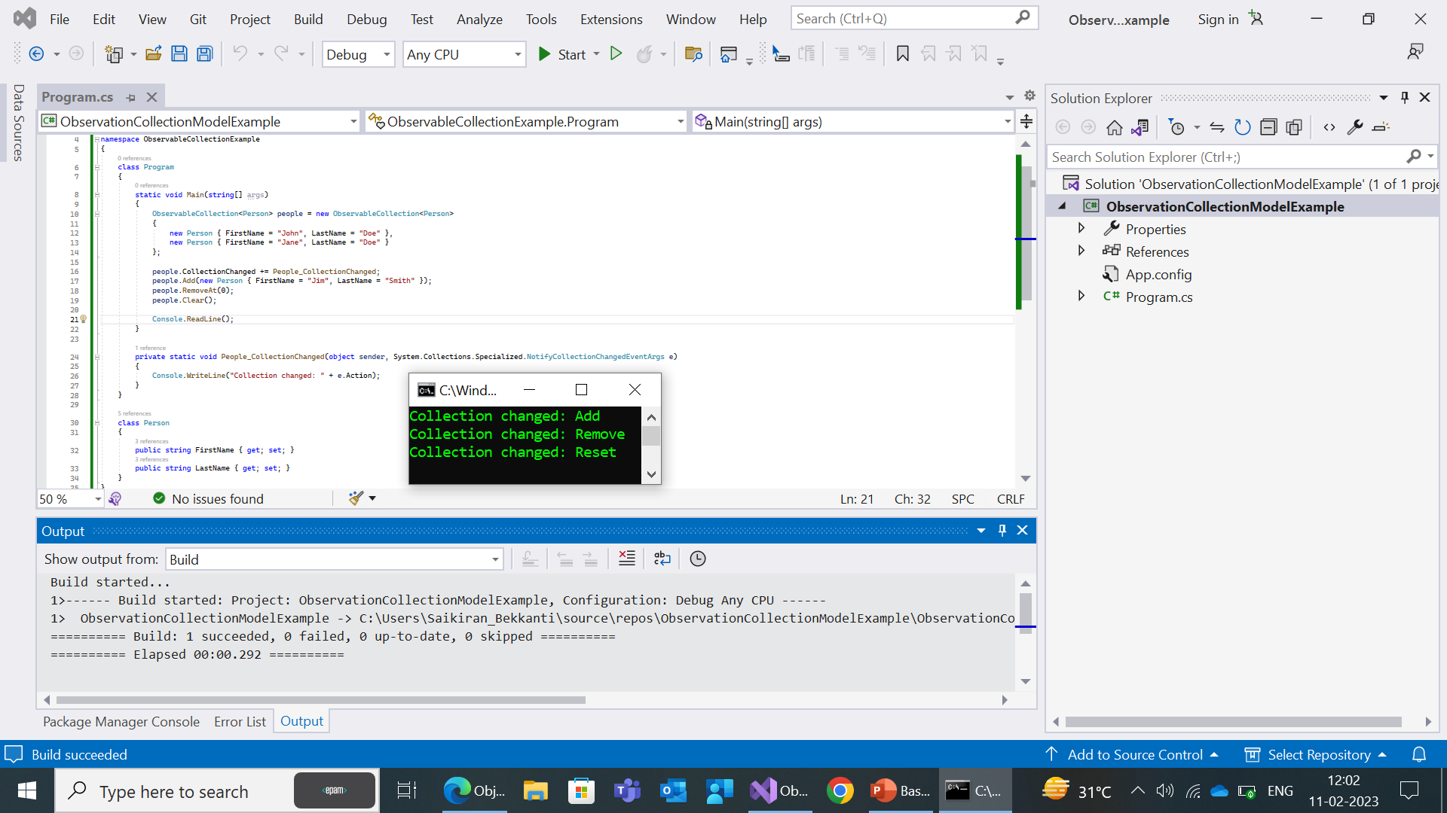

Slide 78
ReadOnlyCollection<T>:
A read-only collection is a collection that cannot be modified once it has been created. In other words, you can't add, remove, or change any elements in a read-only collection after it has been initialized.
Count: Gets the number of elements in the collection.
IndexOf: Searches for the specified object and returns the zero-based index of the first occurrence within the entire collection.
Contains: Determines whether the collection contains a specific value.
ReadOnlyDictionary<TKey, TValue>:
A read-only dictionary is a collection that allows you to store key-value pairs where the keys are unique and cannot be modified once they have been added to the dictionary. Unlike a regular dictionary, a read-only dictionary cannot be modified after it has been created.
Count: Gets the number of elements in the dictionary.
Keys: Gets an IReadOnlyCollection<TKey> that contains the keys in the dictionary.

Slide 79
KeyedCollection<TKey, TItem>:
A KeyedCollection has features of both dictionaries and collections.
It stores data in an ordered structure (like a collection), but also allows item lookup by both indexes and keys.
Keyed collections are appropriate when the key is present inside the object.
Add: Adds an item to the collection.
Remove: Removes the first occurrence of a specific object from the collection.
Clear: Removes all items from the collection.
Contains: Determines whether the collection contains a specific value.

Slide 80
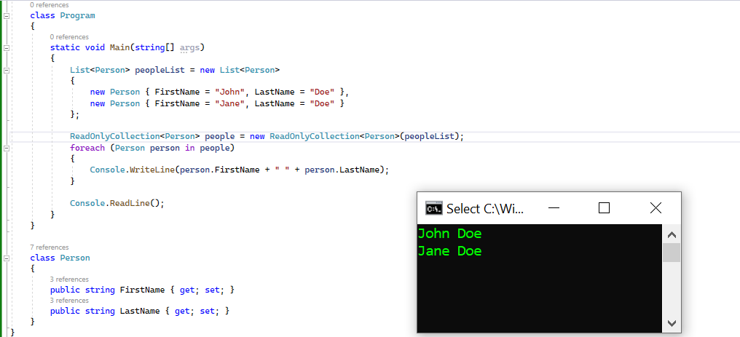

Slide 81
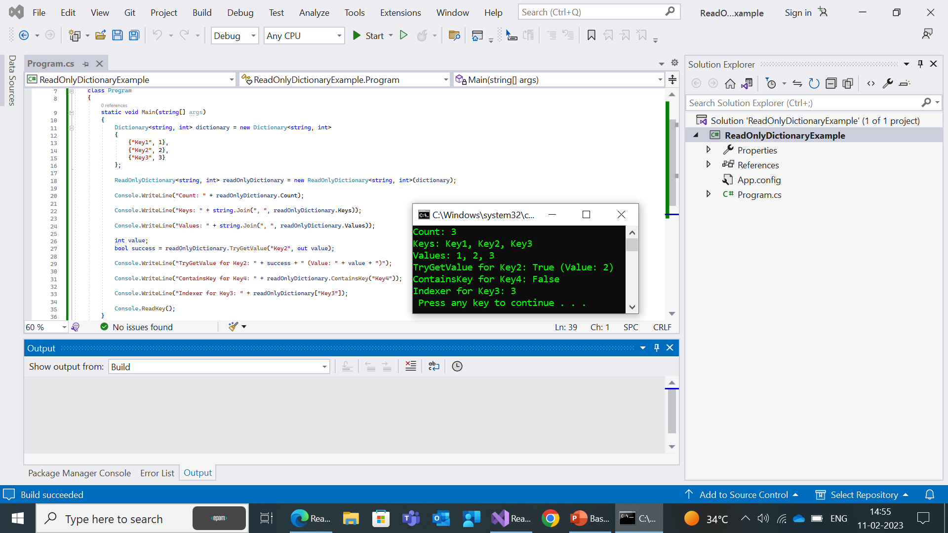

Slide 82
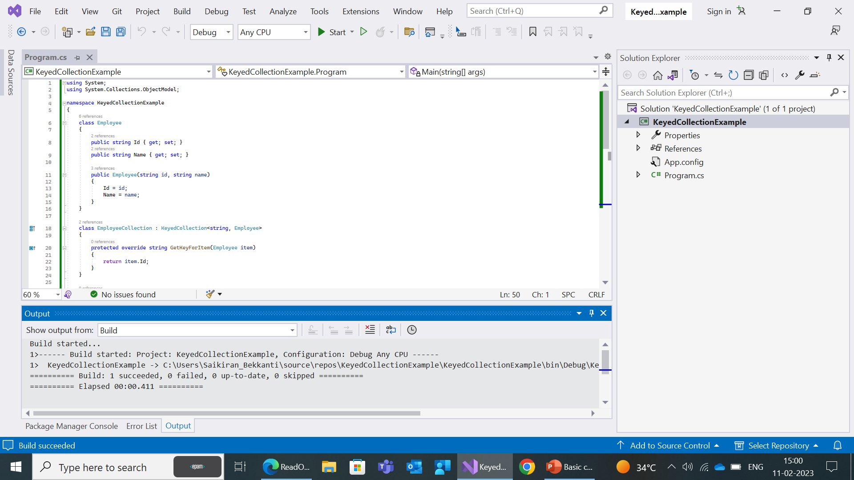
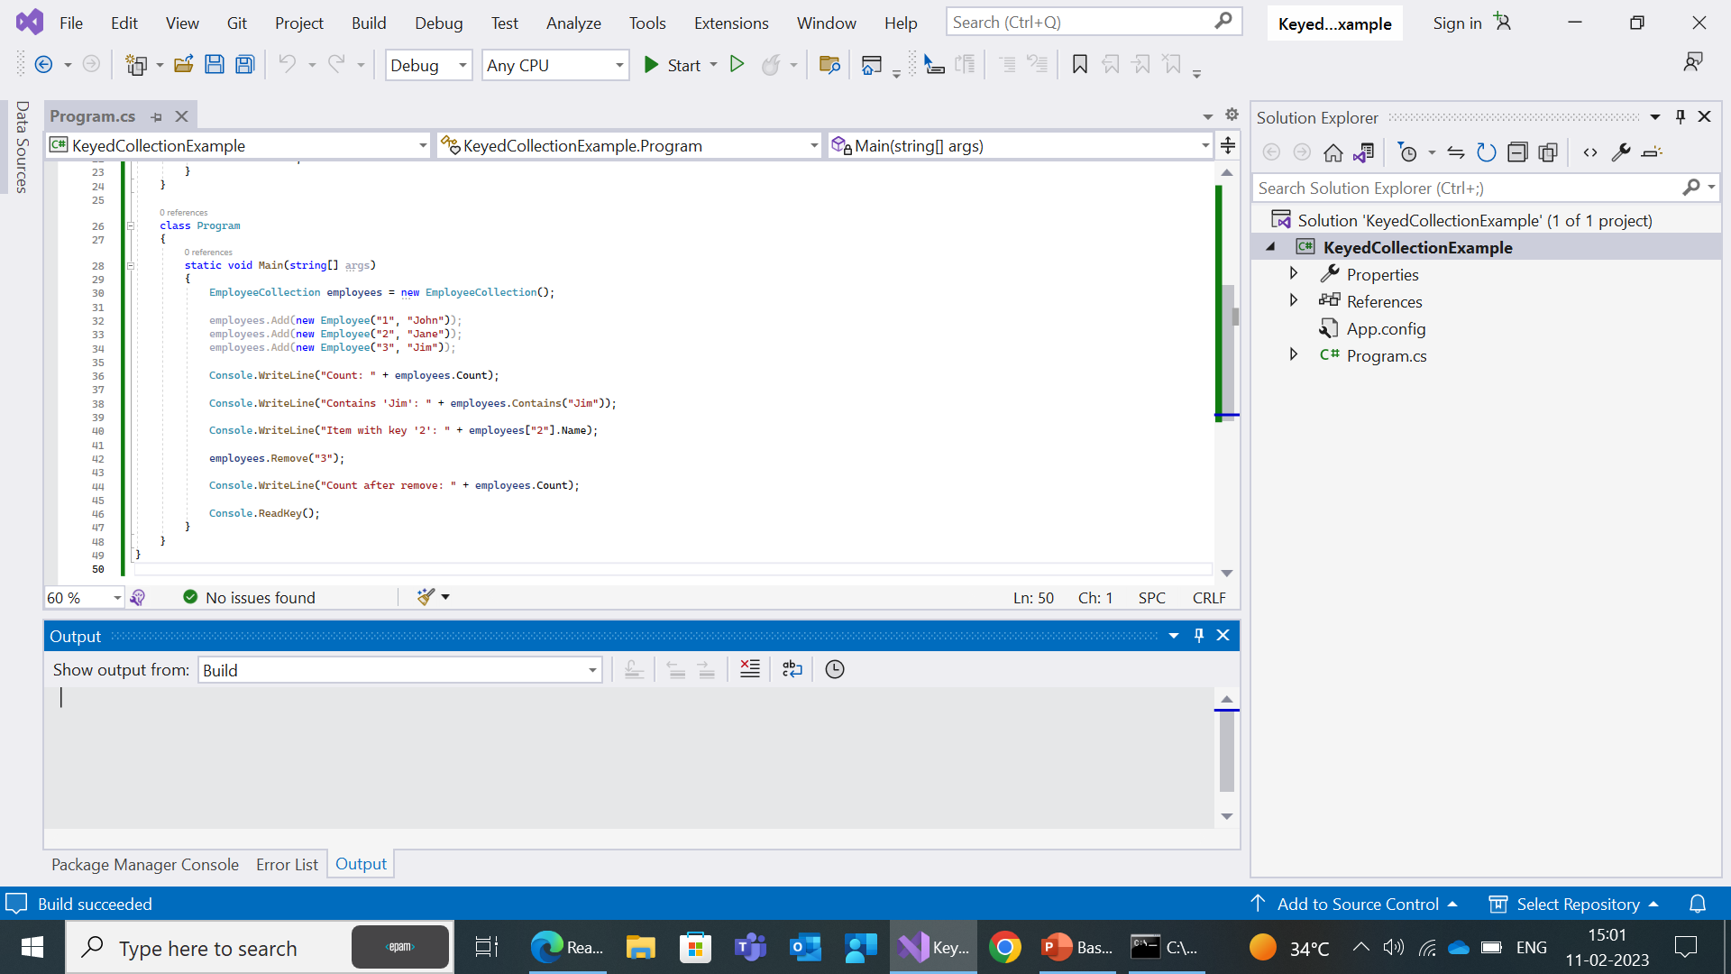


Slide 83
Specialized Collections
Contains specialized and strongly-typed collections; for example, a linked list dictionary, a bit vector, and collections that contain only strings.
System.Collections.Specialized namespace is part of the .NET framework and contains a set of specialized collections that are designed to store and manage data in specific ways. These collections provide specialized functionality that is not available in the standard collections in the System.Collections namespace.
Some of the specialized collections included in the System.Collections.Specialized namespace are:
StringCollection: A collection of strings.
StringDictionary: A dictionary of strings where the keys and values are strings.
NameValueCollection: A collection of key-value pairs where each key is associated with one or more values.

Slide 84
HybridDictionary: A dictionary that uses both a hash table and a list to store its elements, providing fast access times for small collections and memory efficiency for large collections.
ListDictionary: A dictionary that uses a linked list to store its elements, providing efficient access times for small collections.
OrderedDictionary: A dictionary that maintains the order in which elements were added, allowing elements to be accessed in the order they were added.
These collections provide a convenient way to store and manage data in C#

Slide 85
StringCollection
The StringCollection class in C# provides a collection of strings. It is part of the System.Collections.Specialized namespace in the .NET framework.
Here are some of the most commonly used methods of the StringCollection class:
Add: Adds a string to the end of the collection.
Insert: Inserts a string at the specified index in the collection.
Remove: Removes a string from the collection.
Count: Gets the number of strings in the collection.

Slide 86
RemoveAt: Removes a string at the specified index in the collection.
Contains: Determines whether the collection contains a specified string.
IndexOf: Gets the index of the specified string in the collection.
Clear: Removes all strings from the collection.
CopyTo: Copies the strings in the collection to an array.
These methods provide a convenient way to manage strings in a collection and perform common operations, such as adding, removing, and searching for strings.
The StringCollection class is particularly useful when you need to store a collection of strings and perform operations on them efficiently.

Slide 87
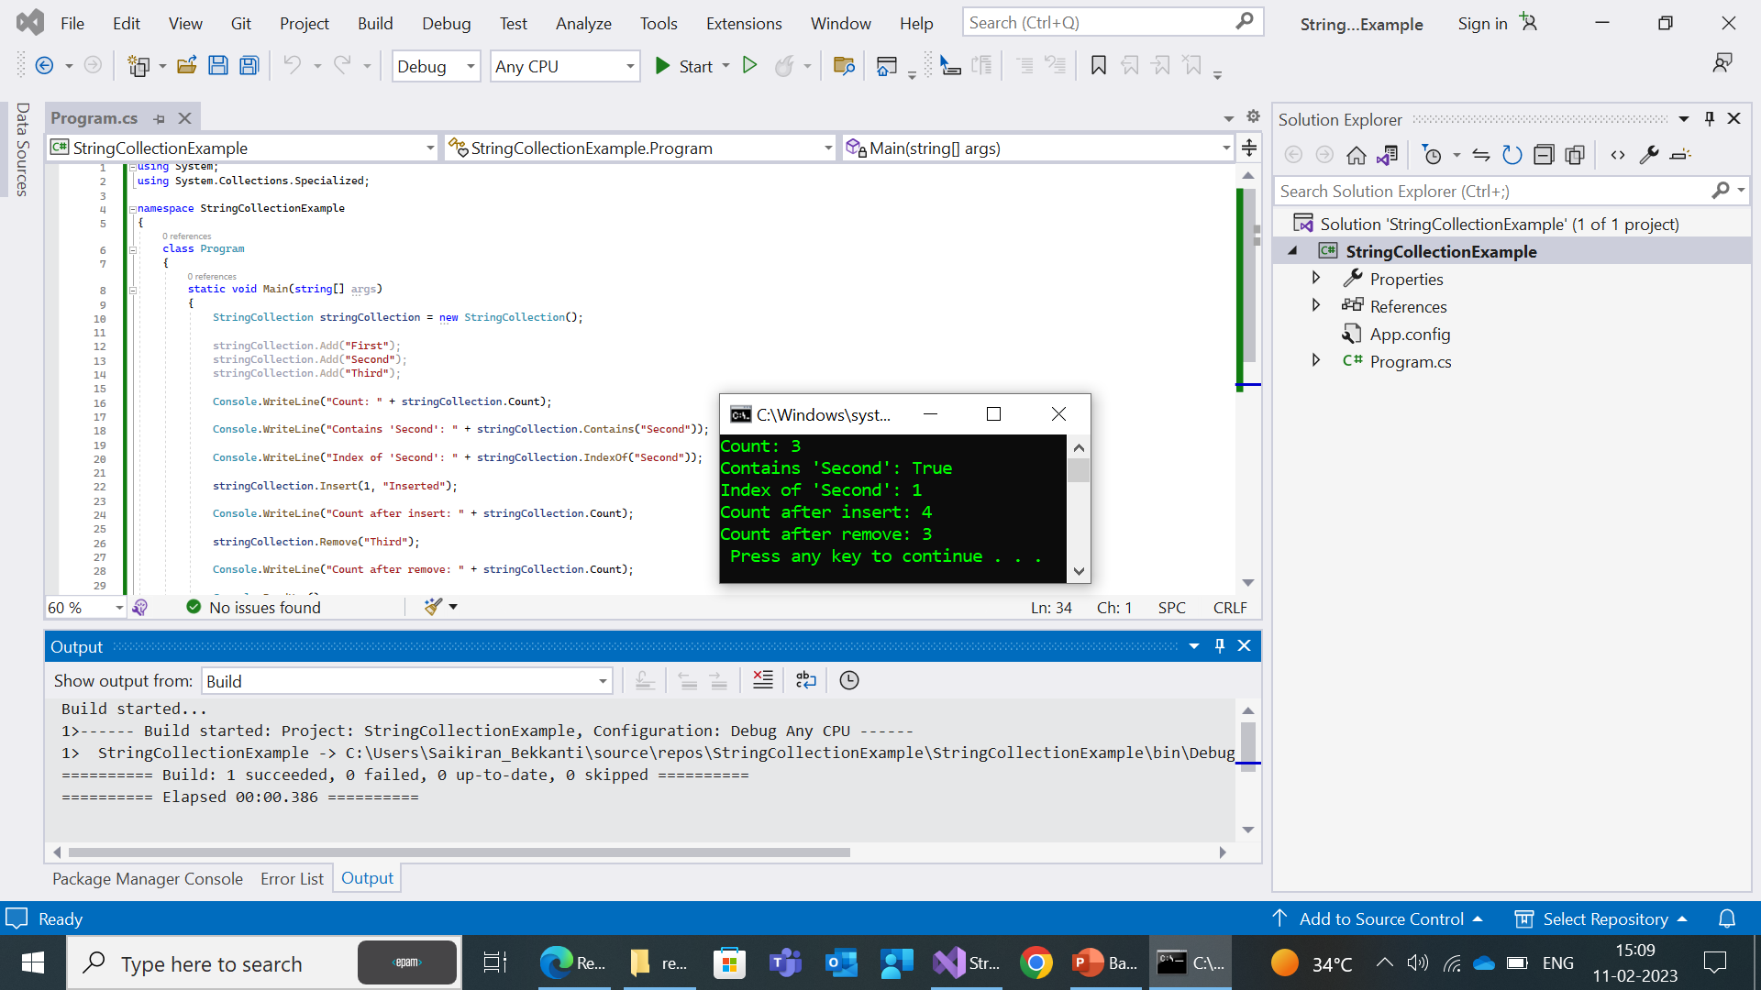

Slide 88
StringDictionary
The StringDictionary class in C# provides a dictionary of strings where the keys and values are strings. It is part of the System.Collections.Specialized namespace in the .NET framework.
Here are some of the most commonly used methods of the StringDictionary class:
Add: Adds a key-value pair to the dictionary.
Remove: Removes a key-value pair from the dictionary.
ContainsKey: Determines whether the dictionary contains a specified key.
ContainsValue: Determines whether the dictionary contains a specified value.

Slide 89
Clear: Removes all key-value pairs from the dictionary.
Keys: Gets a collection of all keys in the dictionary.
Values: Gets a collection of all values in the dictionary.
Count: Gets the number of key-value pairs in the dictionary.
These methods provide a convenient way to manage key-value pairs in a dictionary and perform common operations, such as adding, removing, and searching for keys and values. The StringDictionary class is particularly useful when you need to store a dictionary of strings and perform operations on them efficiently.

Slide 90
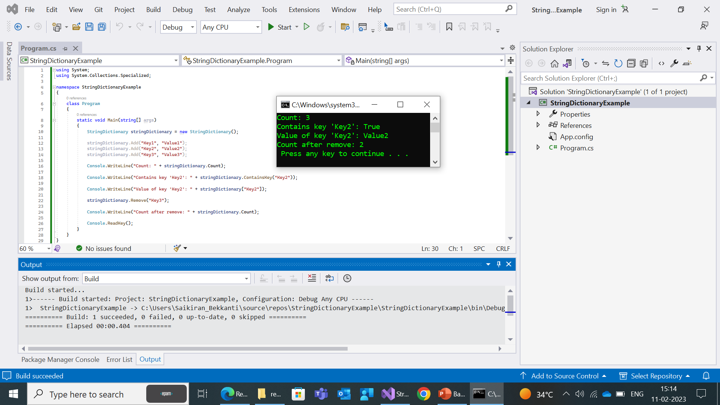

Slide 91
NameValueCollection
The NameValueCollection class in C# provides a collection of key-value pairs where each key is associated with one or more values. It is part of the System.Collections.Specialized namespace in the .NET framework.
Here are some of the most commonly used methods of the NameValueCollection class:
Add: Adds a key-value pair to the collection.
Set: Sets the value for a specified key in the collection.
Remove: Removes a key-value pair from the collection.
GetValues: Gets the values for a specified key in the collection.
ContainsKey: Determines whether the collection contains a specified key.

Slide 92
Get: Gets the value for a specified key in the collection.
AllKeys: Gets an array of all keys in the collection.
Count: Gets the number of key-value pairs in the collection.
These methods provide a convenient way to manage key-value pairs in a collection and perform common operations, such as adding, removing, and searching for keys and values. The NameValueCollection class is particularly useful when you need to store a collection of key-value pairs and perform operations on them efficiently.

Slide 93
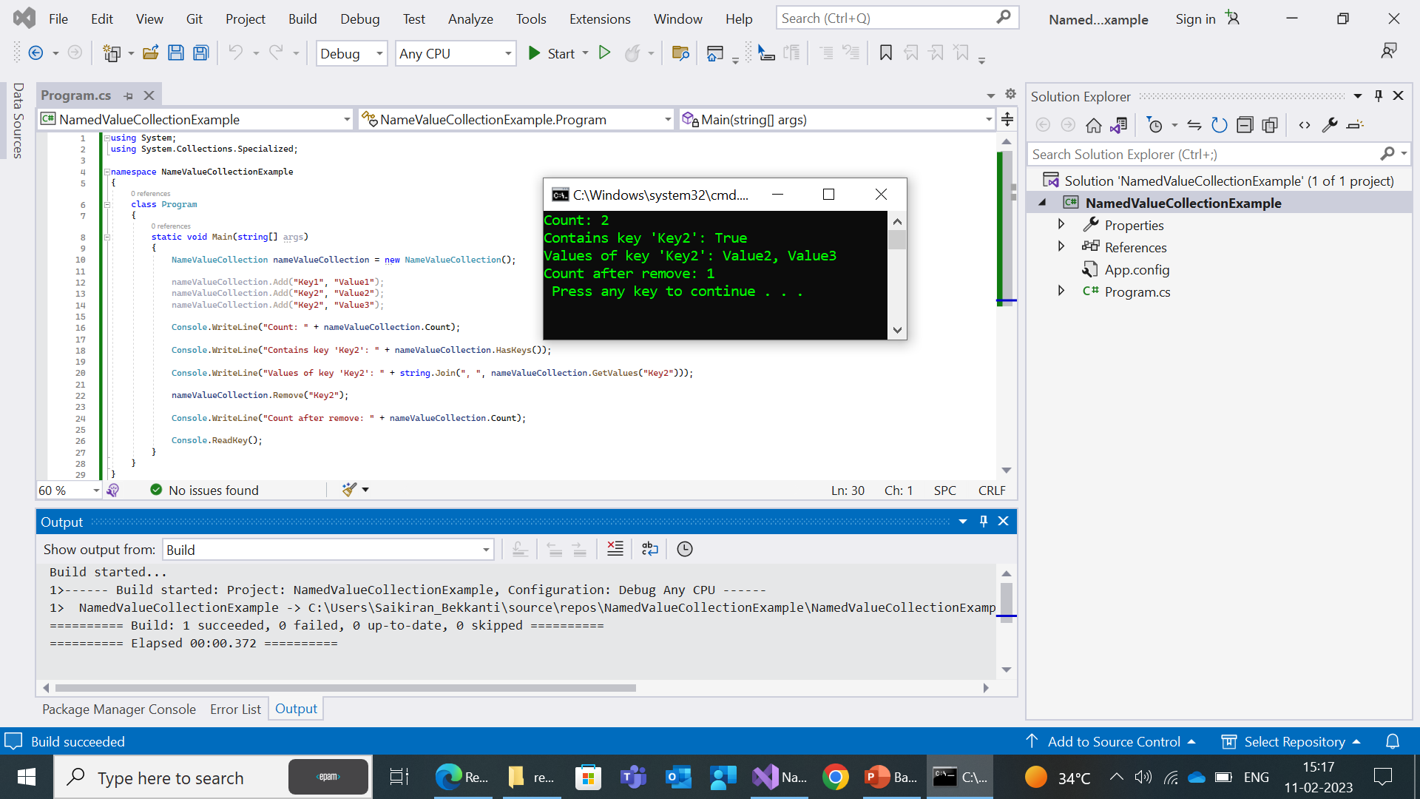

Slide 94
HybridDictionary
The HybridDictionary class in C# provides a dictionary where keys are associated with values. It is part of the System.Collections.Specialized namespace in the .NET framework.
The HybridDictionary class is a hybrid data structure that starts as a hash table and switches to a list-based data structure when the number of elements in the collection grows beyond a specified threshold. This provides the best of both worlds, with the performance benefits of a hash table when the collection is small, and the performance benefits of a list-based data structure when the collection is large.
Here are some of the most commonly used methods of the HybridDictionary class:
Add: Adds a key-value pair to the dictionary.
Remove: Removes a key-value pair from the dictionary.

Slide 95
Contains: Determines whether the dictionary contains a specified key.
Clear: Removes all key-value pairs from the dictionary.
Keys: Gets a collection of all keys in the dictionary.
Values: Gets a collection of all values in the dictionary.
Count: Gets the number of key-value pairs in the dictionary.
These methods provide a convenient way to manage key-value pairs in a dictionary and perform common operations, such as adding, removing, and searching for keys and values. The HybridDictionary class is particularly useful when you need to store a dictionary of items and perform operations on them efficiently, especially when the size of the collection can vary widely.

Slide 96
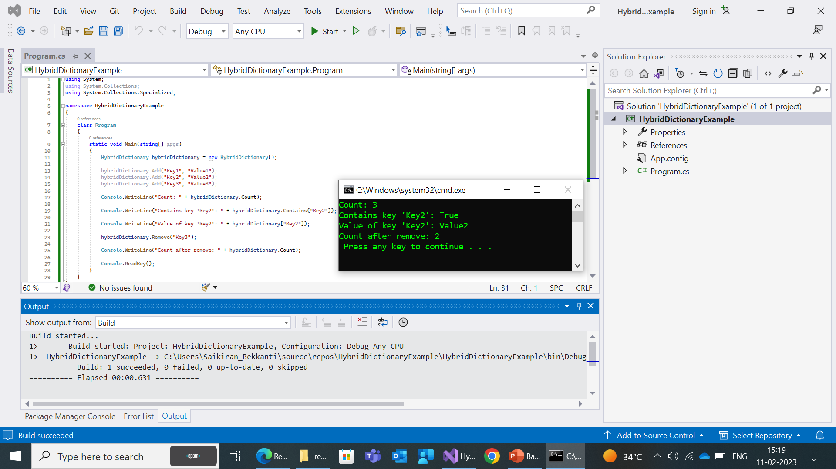

Slide 97
ListDictionary
The ListDictionary class in C# provides a dictionary where keys are associated with values. It is part of the System.Collections.Specialized namespace in the .NET framework.
The ListDictionary class is a list-based data structure that provides fast lookups and retrievals when the number of elements in the collection is small. It is not as fast as a hash table, but it is more memory-efficient.
Here are some of the most commonly used methods of the ListDictionary class:
Add: Adds a key-value pair to the dictionary.
Remove: Removes a key-value pair from the dictionary.
Contains: Determines whether the dictionary contains a specified key.

Slide 98
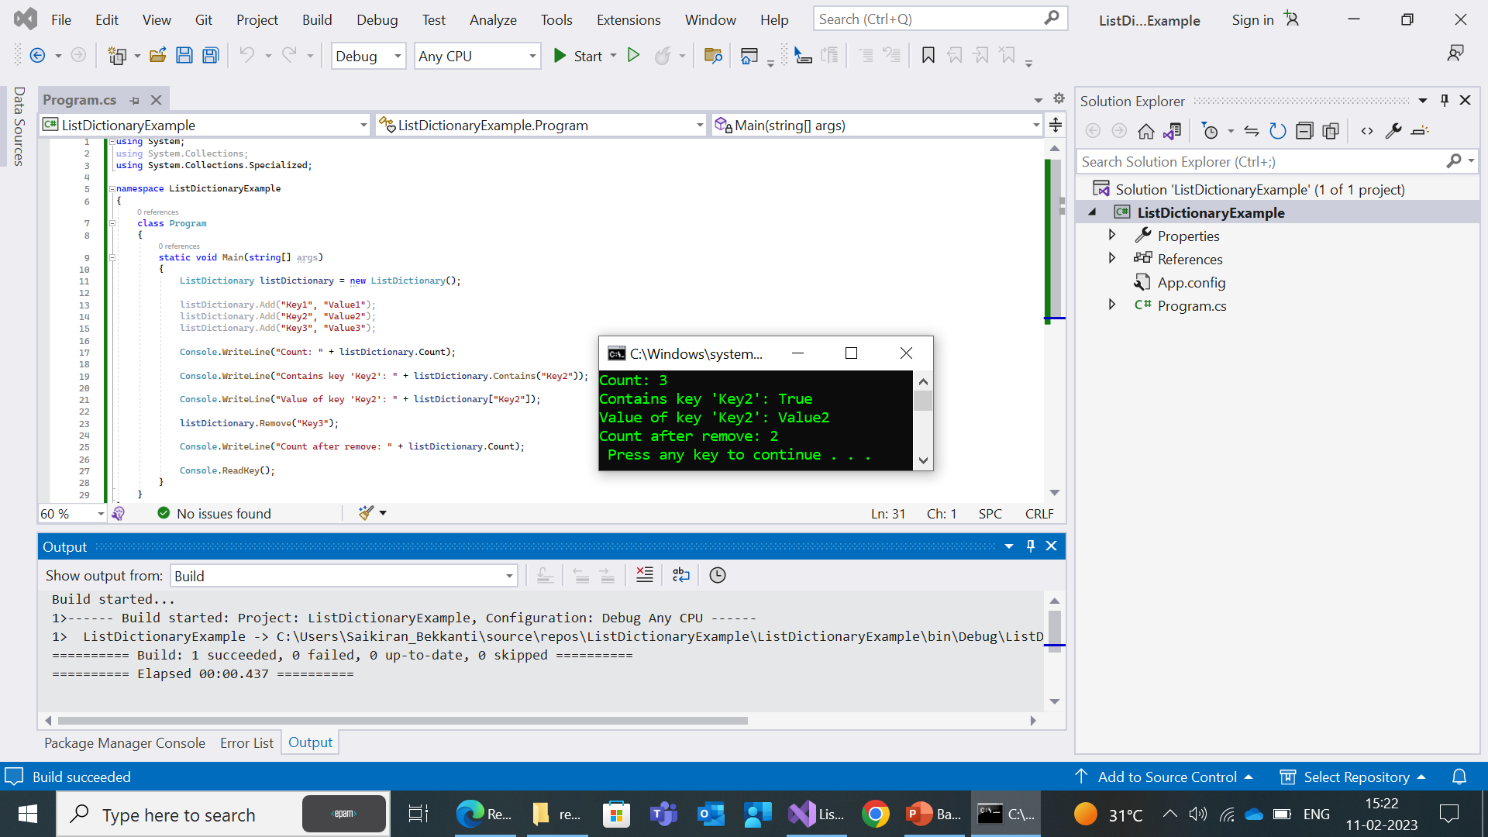

Slide 99
OrderedDictionary
OrderedDictionary: A dictionary that maintains the order in which elements were added, allowing elements to be accessed in the order they were added.
OrderedDictionary class is a specialized collection in .NET that provides a dictionary data structure that maintains the order of its elements.
This means that elements are stored in a specific order and when iterated, they are returned in the order in which they were added.

Slide 100
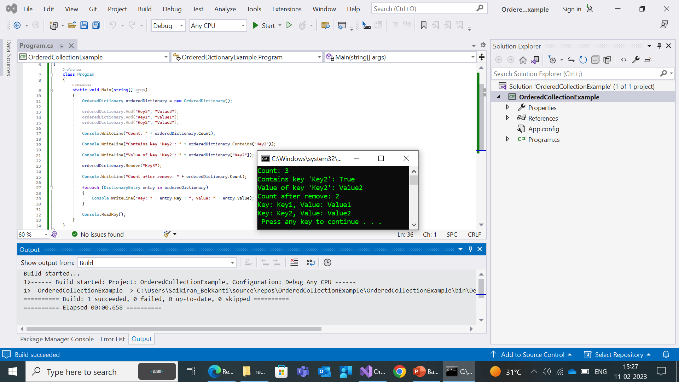

Slide 101
Reflections
Reflection in C# is a feature of the .NET framework that enables you to inspect and interact with the metadata of types, objects, and assemblies at runtime.
Using reflection, you can obtain information about types and members, create instances of types, access fields, properties, and methods, and even modify the contents of fields, properties, and methods.
you can access the System.Reflection namespace, which contains classes such as Type, Assembly, MethodInfo, and others that allow you to perform various tasks related to reflection.
For performing late binding, accessing methods on types created at run time.
In late binding the compiler does not know about what kind of object it is and what are the methods and properties it holds,here the objects are dynamic objects.

Slide 102
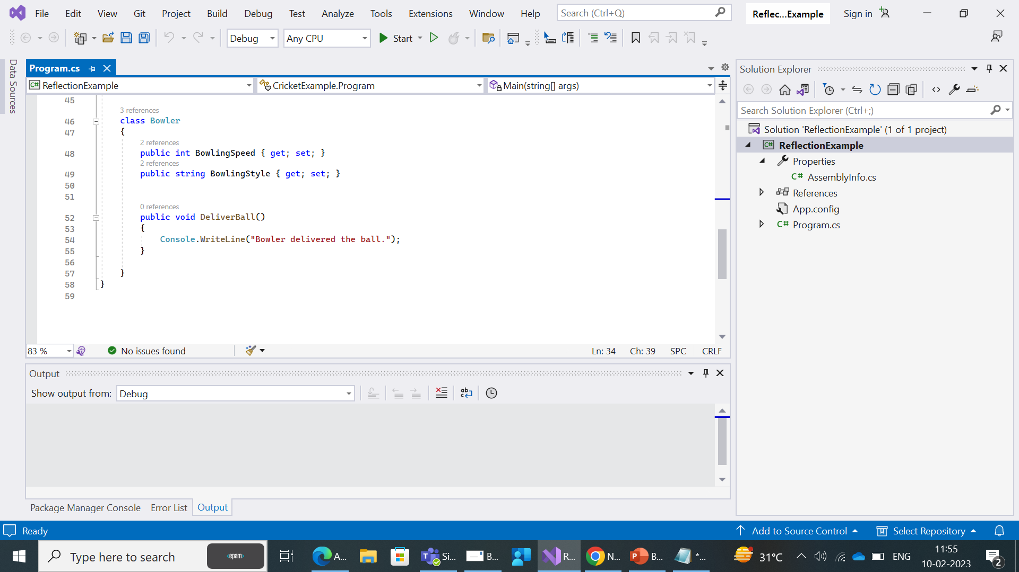
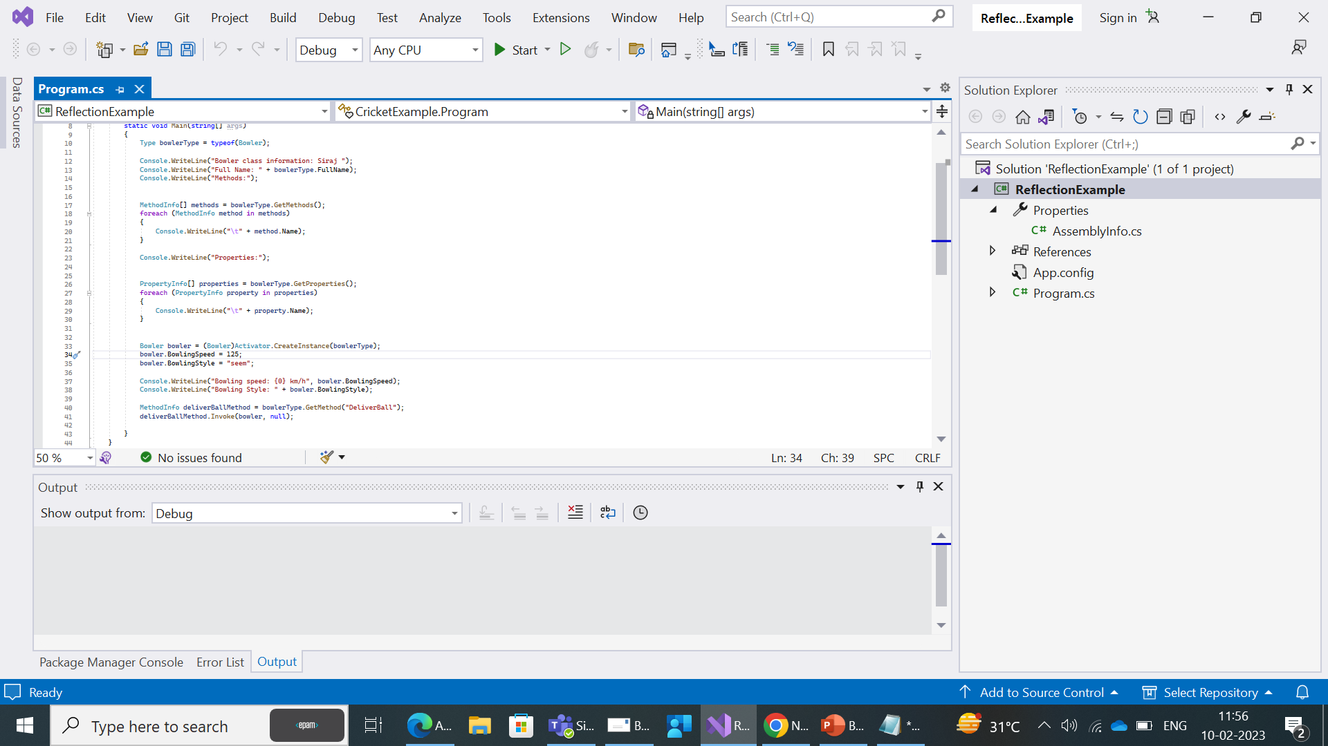
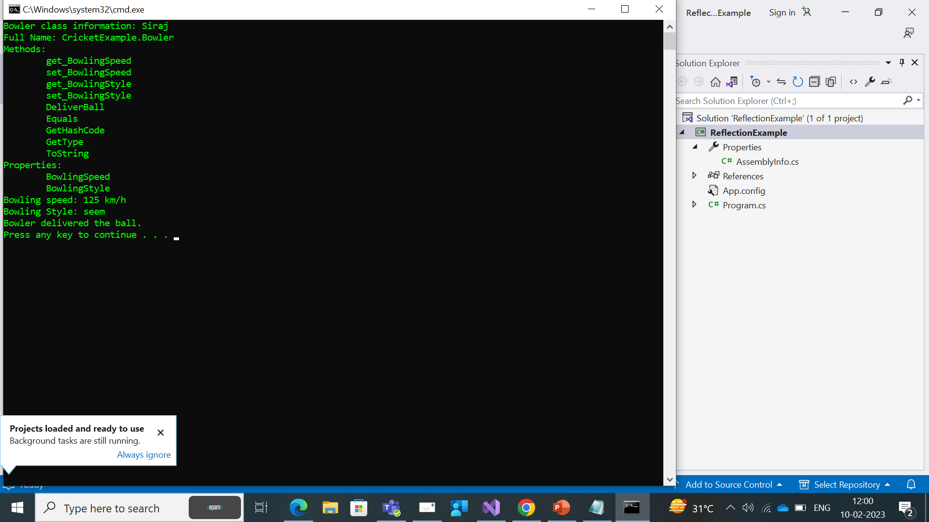

Slide 103
Ref and out Keywords
Ref and out keywords in C# are used to pass arguments within a method or function. Both indicate that an argument/parameter is passed by reference.
By default parameters are passed to a method by value. By using these keywords (ref and out) we can pass a parameter by reference.
The ref keyword passes arguments by reference. It means any changes made to this argument in the method will be reflected in that variable when control returns to the calling method.
The out keyword in C# is used in method parameters to indicate that the parameter is being passed as an output value.
Data sent from caller has been discarded and its mandatory to initialize the variables inside the callee. Out is one way from callee to caller.

Slide 104
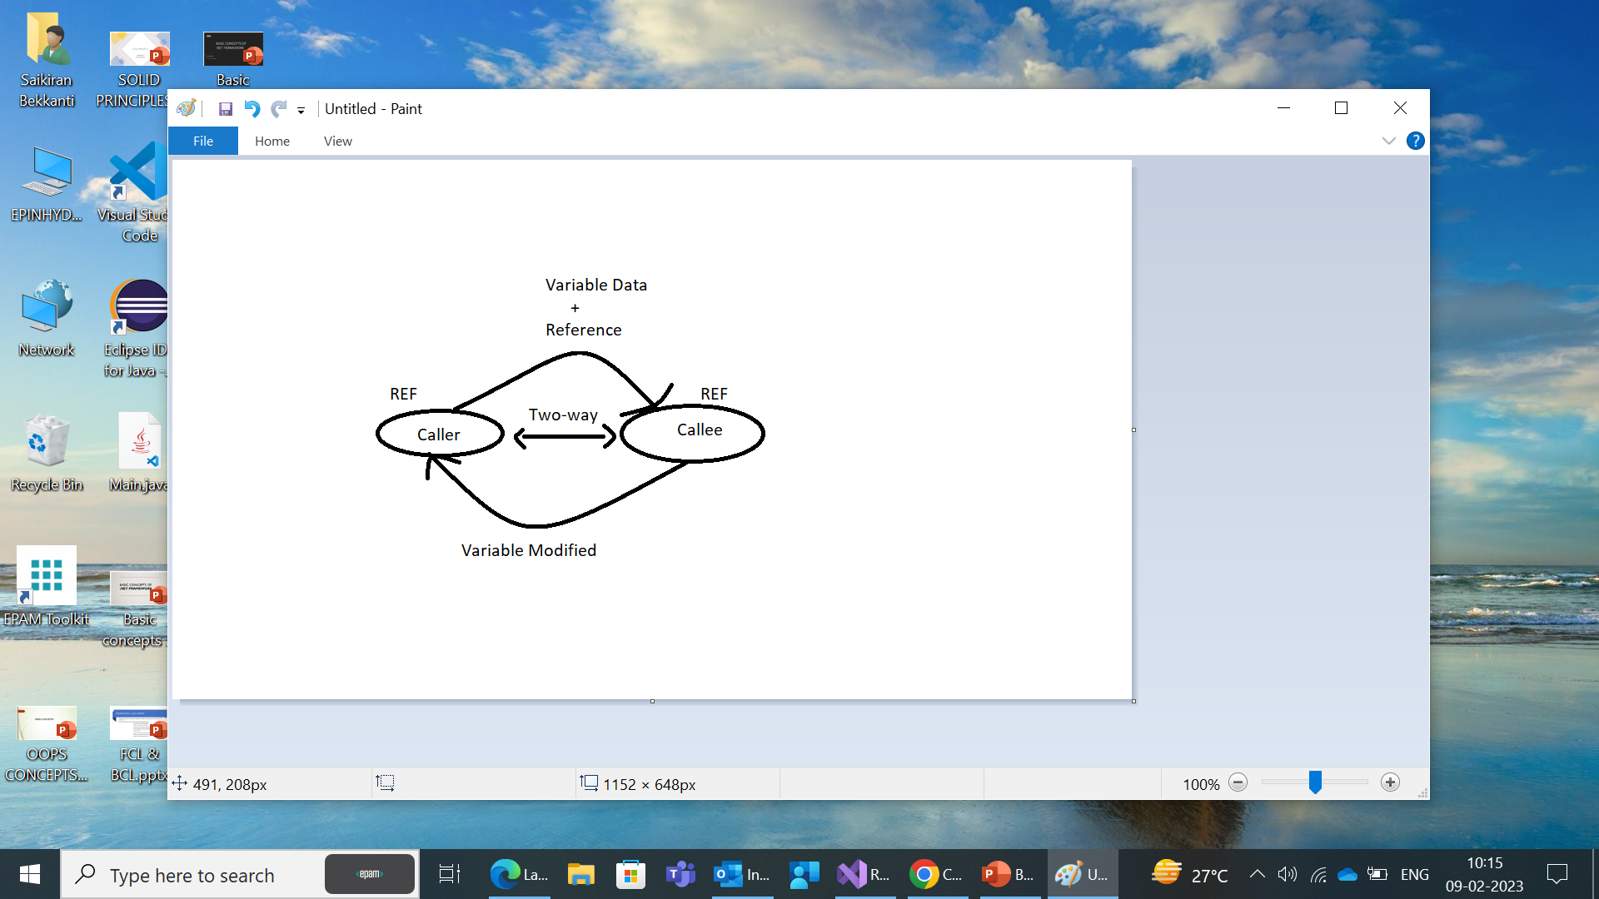
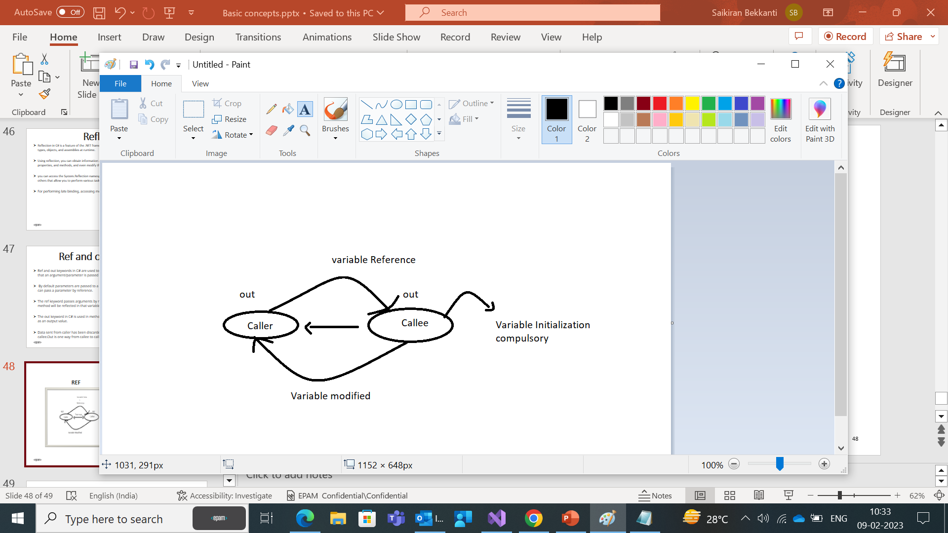
REF
OUT

Slide 105
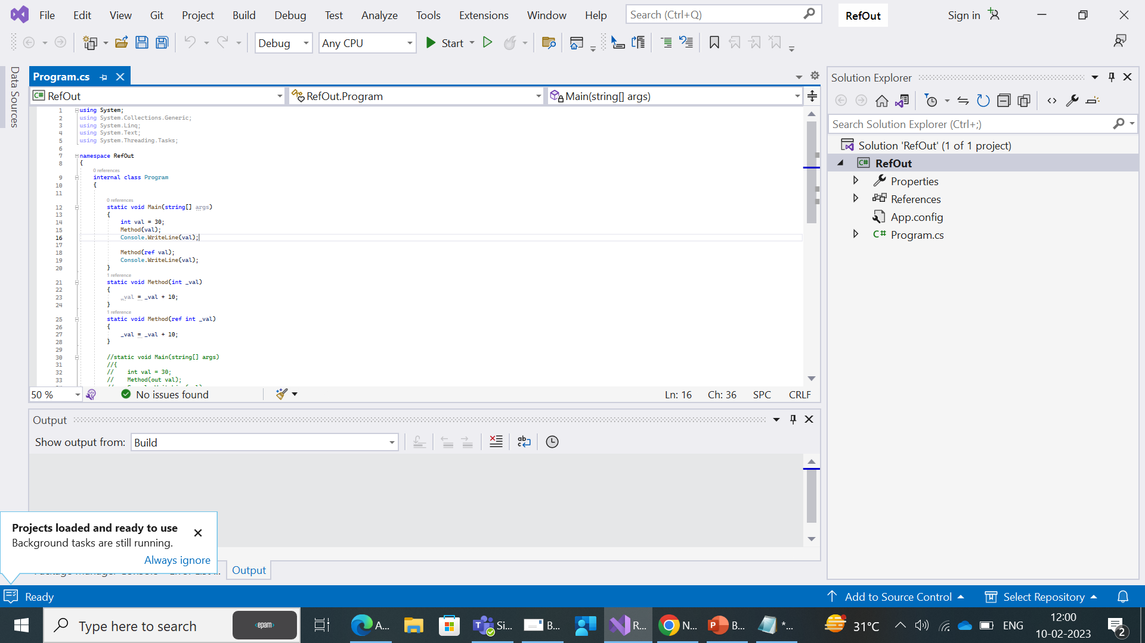
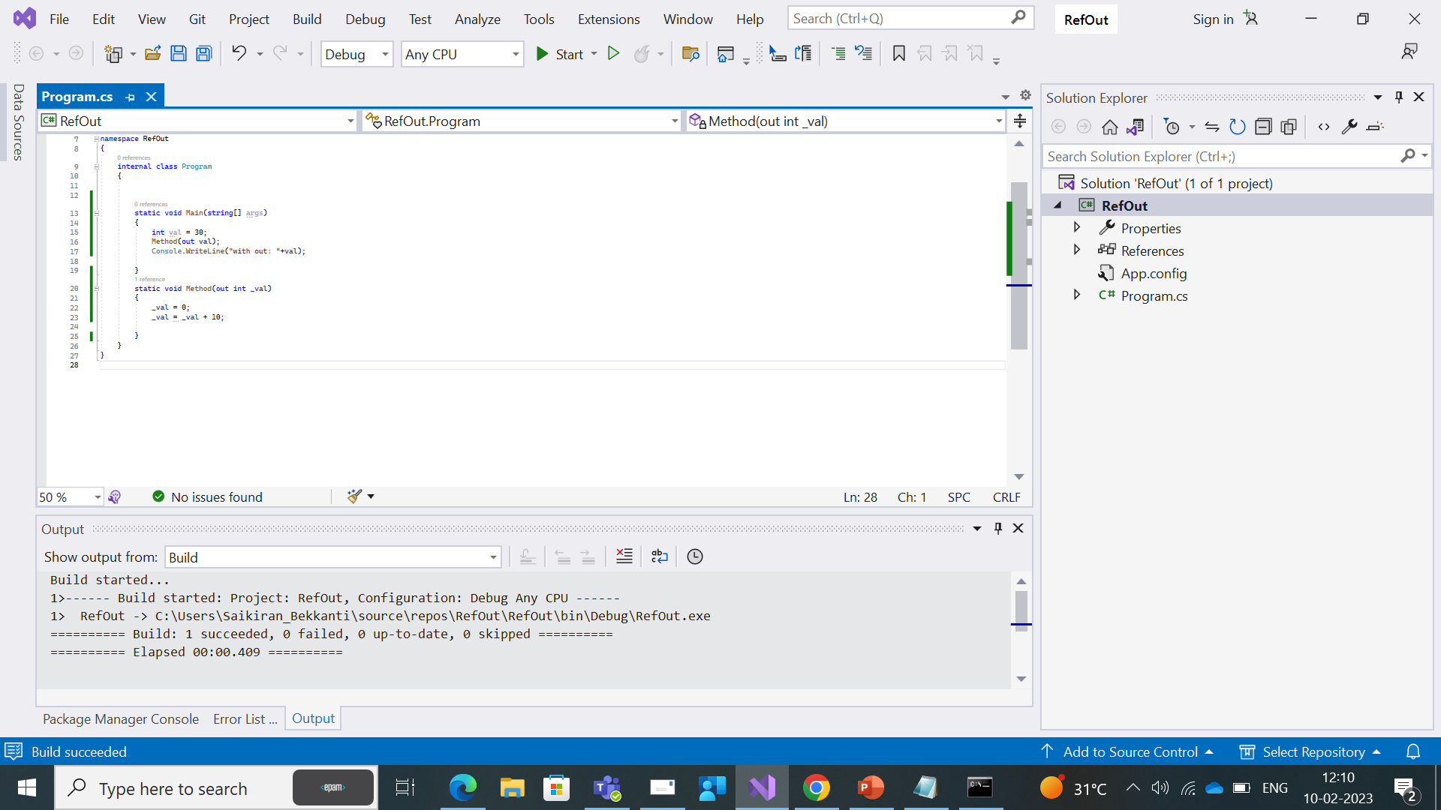

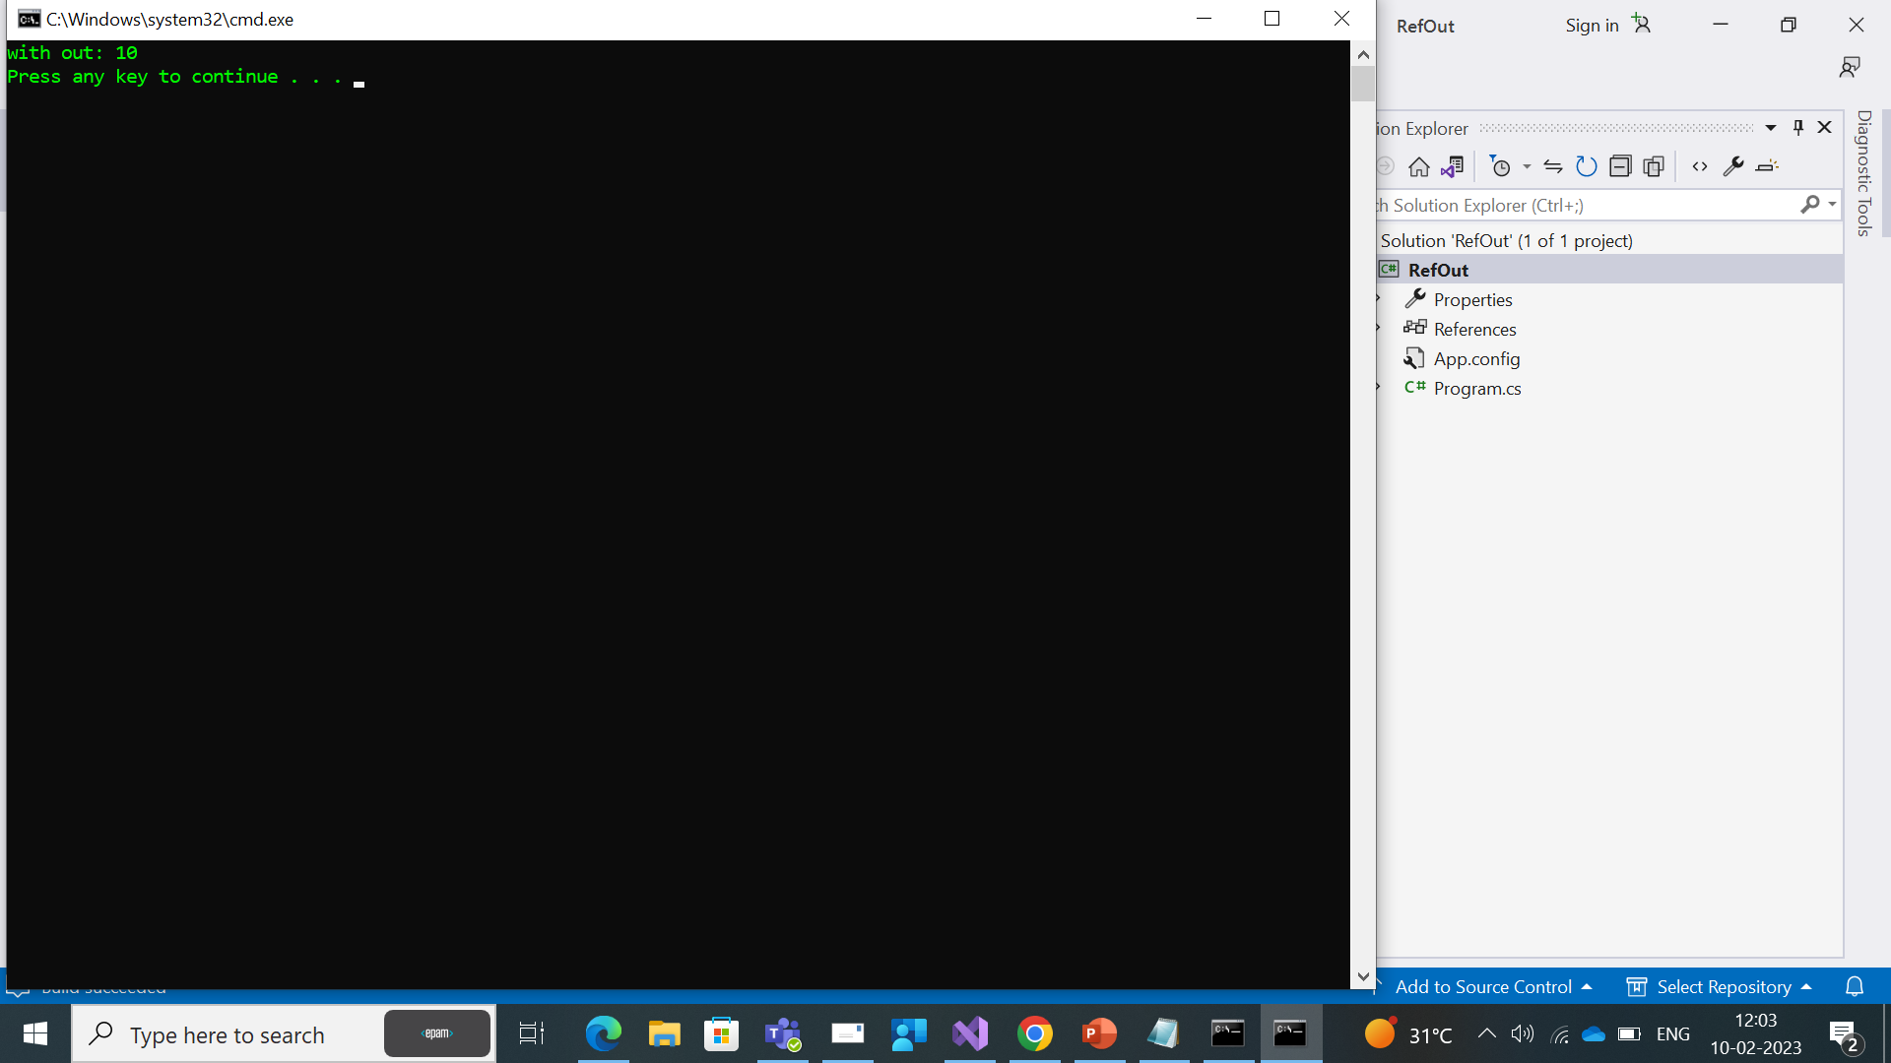

Slide 106
Ref | out
Requires the passed parameter to be initialized before passing. | Doesn’t require passed parameter to be initialized.
It’s not must to assign a value to passed ref parameter inside the method | It is must to assign a value to passed out parameter inside the method.
When we use REF, data can be passed bi-directionally. | When we use OUT data is passed only in a unidirectional way(from callee to the caller)

Slide 107
It Time to test
What is the use of reflection ?
What is mean by Late binding?
What is the namespace for Type?
What is the namespace for Reflection ?
Through which keyword we can pass data bidirectionally ?
What is the direction way for out keyword ?

Slide 108
Dependency Injections
Prepared by
SAI KIRAN BEKKANTI

Slide 109
Dependency Injection using Autofac
Autofac is an open-source Inversion of Control (IoC) container for .NET applications. It provides a mechanism for managing the dependencies between objects in an application, allowing you to write more flexible and maintainable code.
An IoC container, such as Autofac, works by centralizing the management of object creation and dependency resolution. Instead of creating objects manually and passing dependencies directly to their constructors, you register types and their dependencies with the container, and the container creates objects for you and resolves dependencies automatically.
Here are some of the key concepts and features of Autofac in C#:
Types and registrations: To use Autofac, you must first register the types that you want to use in your application. This involves telling Autofac what concrete types to use for interfaces or abstract classes, and what dependencies each type has.

Slide 110
Modules: To simplify configuration, Autofac provides the concept of modules, which are classes that encapsulate type registrations. Modules can be used to group related types and registrations, making it easier to manage your application's dependencies.
Resolving dependencies: To resolve a type from the container, you can use the Resolve method, passing in the type that you want to retrieve. Autofac will then create an instance of the type and any other types that it depends on, using the type registrations that you have defined.
Parameterized registrations: You can pass parameters to the container when resolving a type, allowing you to dynamically provide dependencies that are specific to a particular request.

Slide 111
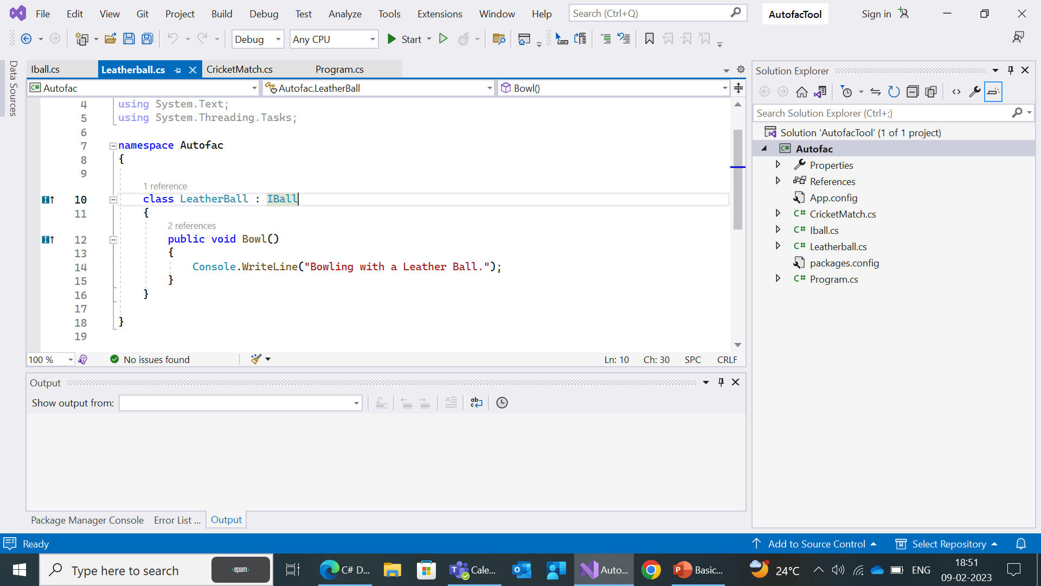
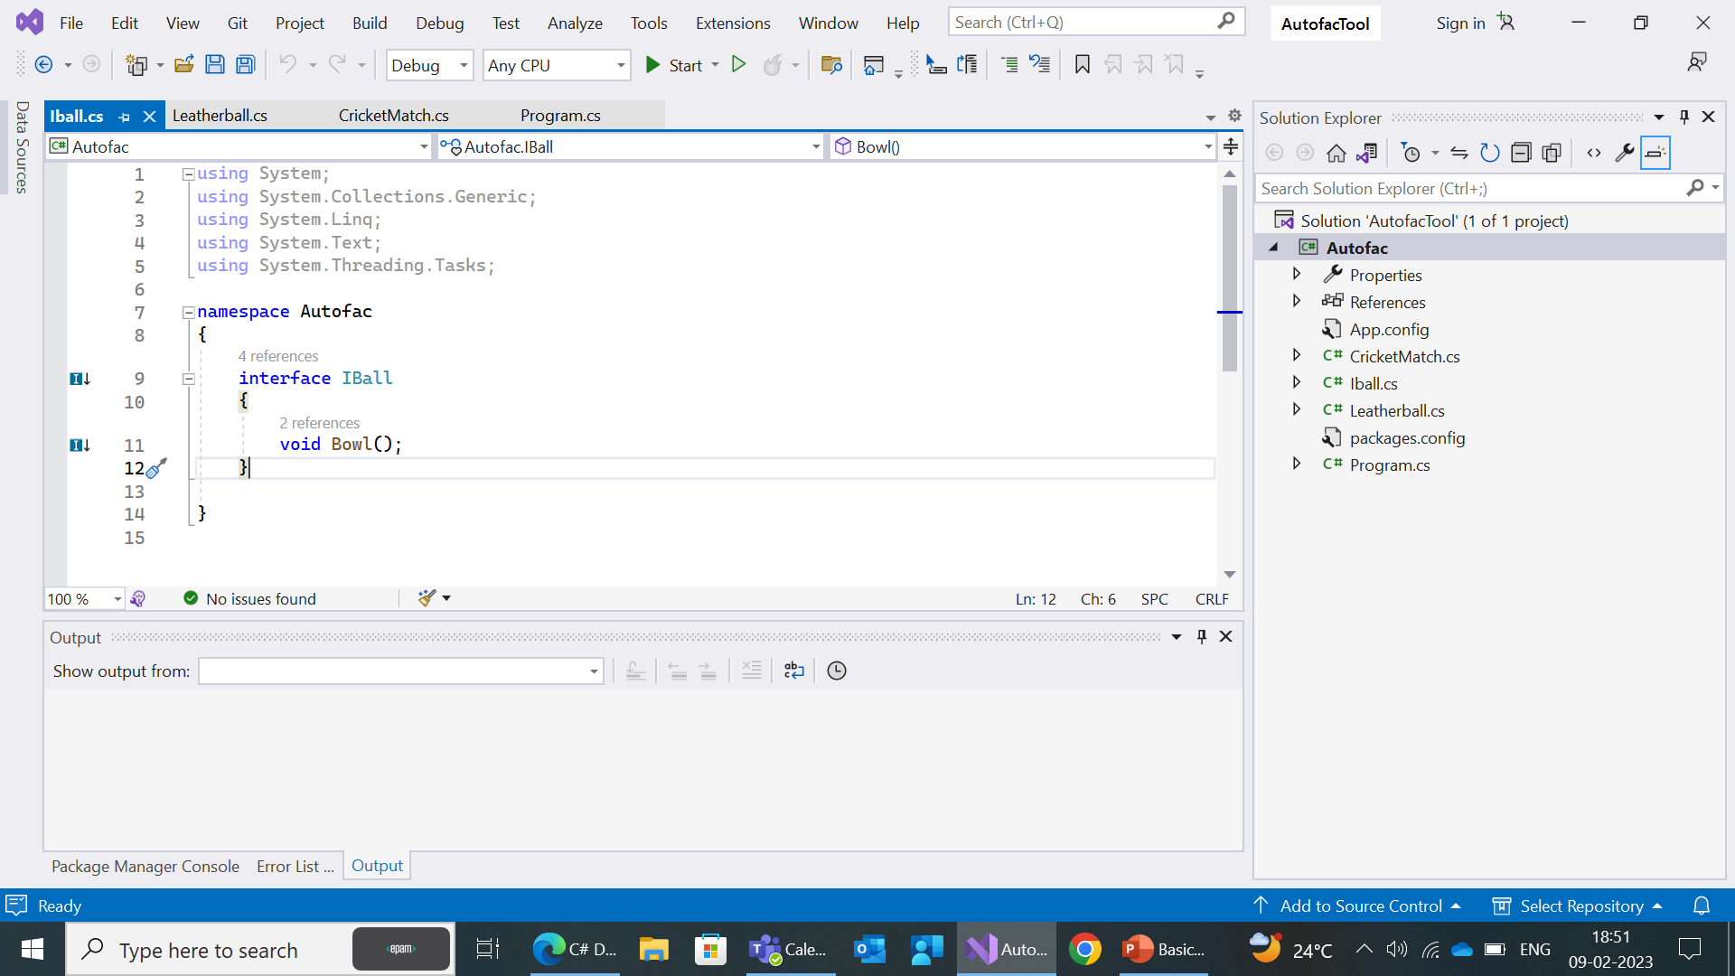

Slide 112
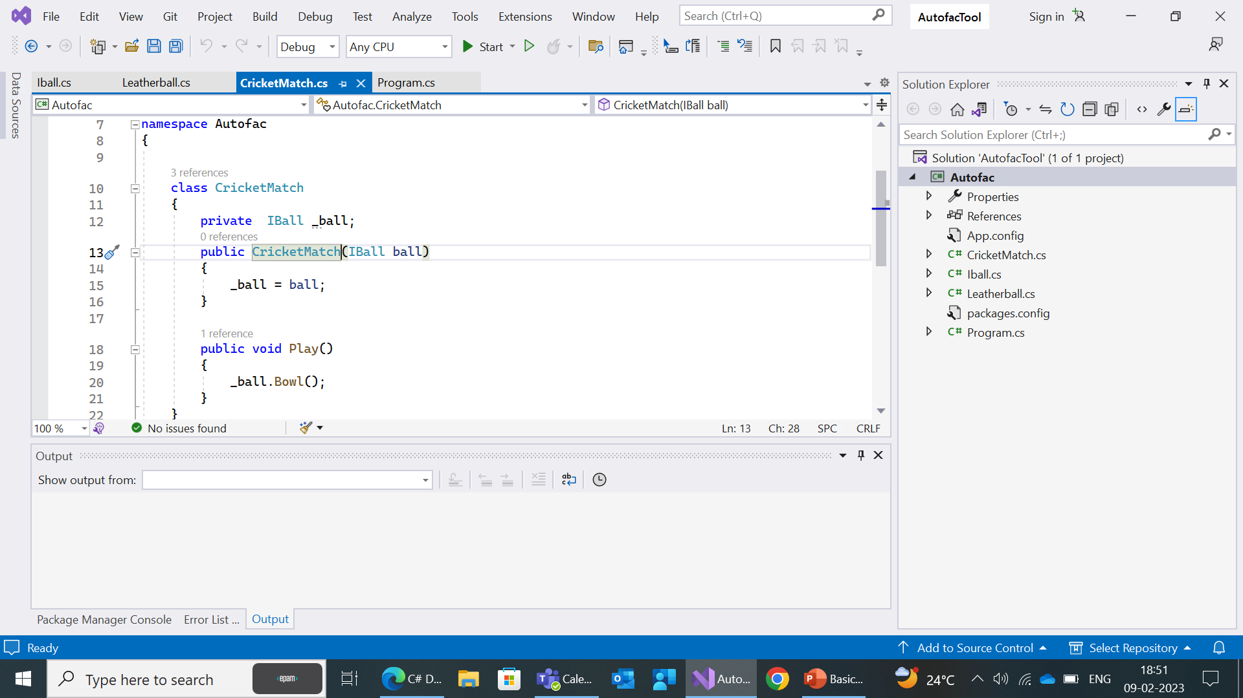
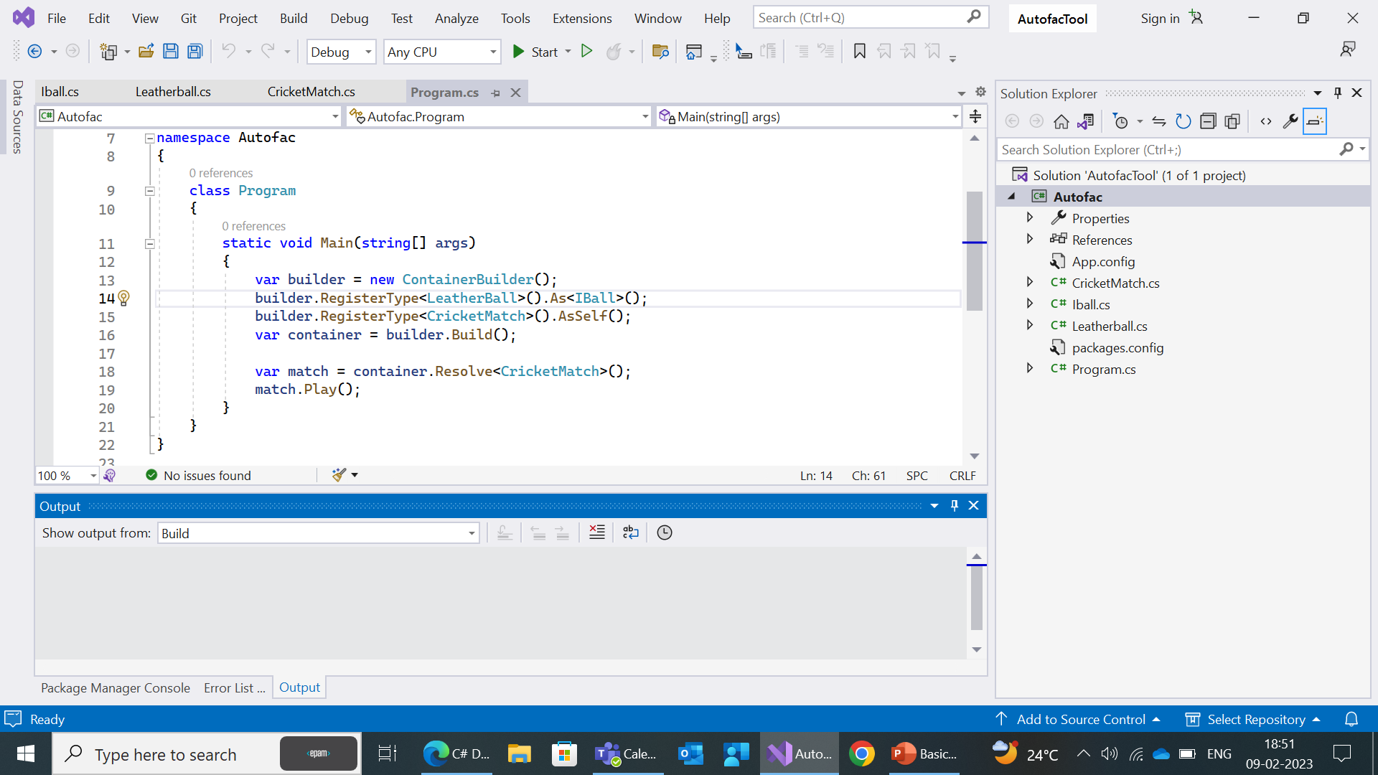


Slide 113
Dependency Injection Using Simple Injector
Simple Injector is a fast and easy-to-use DI container for .NET applications.
We need to install package called SimpleInjector in the package manager console.
It has a small and efficient code base, making it a good choice for performance-critical applications.
It also has a strong focus on verification and helps developers find and fix problems in their code.
Performance: Simple Injector is known for its performance, as it has been optimized for fast resolution of dependencies. Autofac and Unity Container are also fast, but Simple Injector is generally considered to be the fastest of the three.

Slide 114



Slide 115


Slide 116
Dependency Injection using Unity
The Unity Container is part of the Unity framework, which is a set of libraries and tools provided by Microsoft to support the development of modular and extensible applications.
The Unity Container provides a simple and straightforward way to implement dependency injection in your application, and it supports features such as constructor injection, property injection, and method injection.
Ease of Use: Unity Container is known for its simplicity and ease of use.
We need to install package called unity in the package manager console.

Slide 117


Slide 118


